Slide 1
Learning to Detect Light Field Features
Progress Report
15 Jun 2018

Slide 2
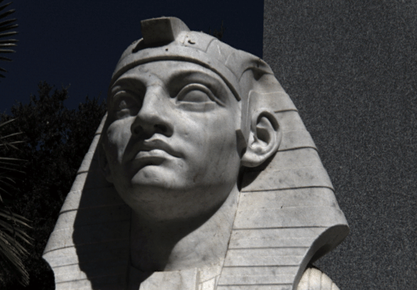
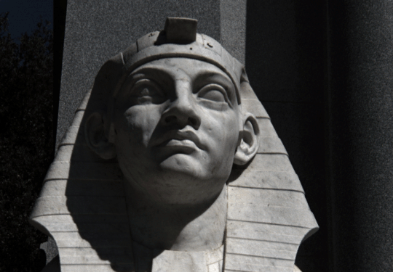
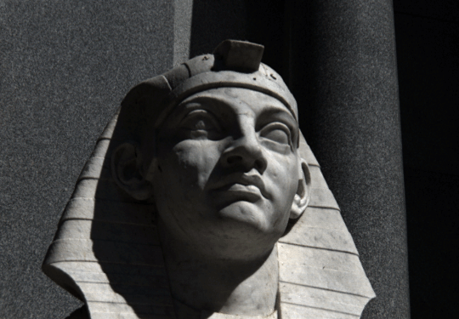
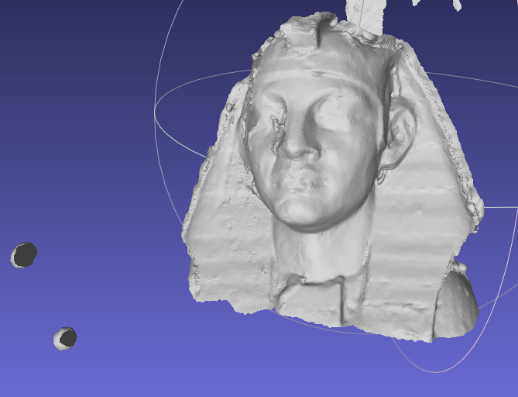
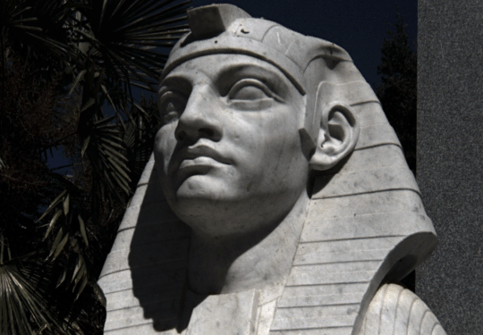
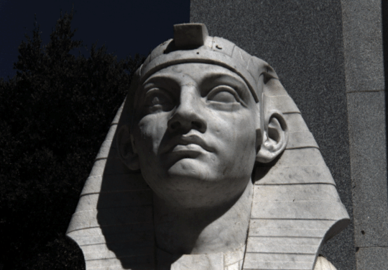
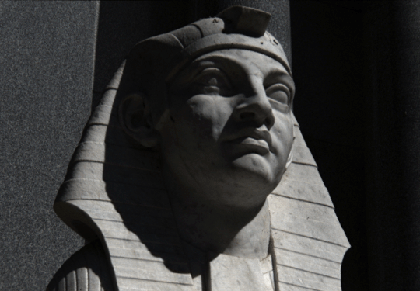
Multi-View 3D Reconstruction
COLMAP meshed
Multiple views with different, unknown camera parameters

Slide 3
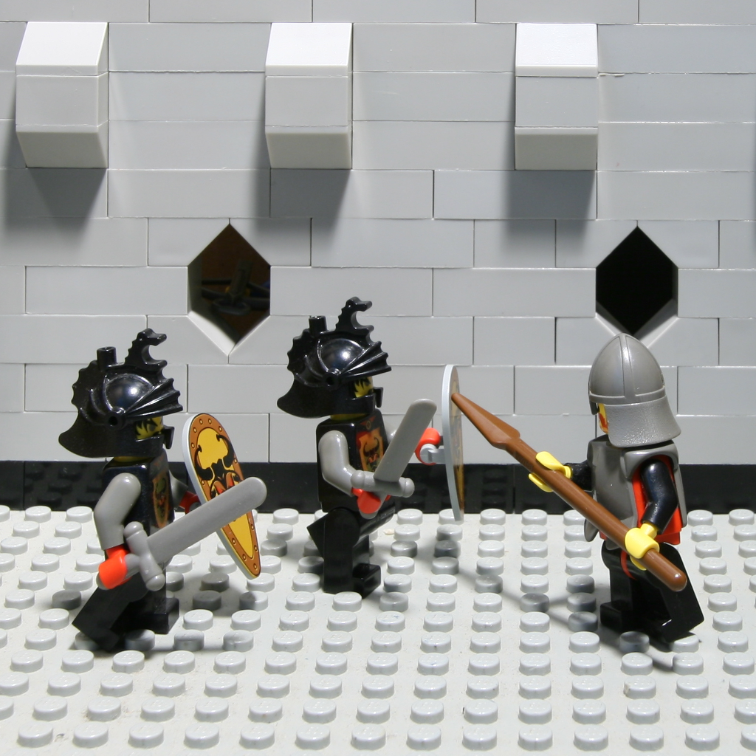
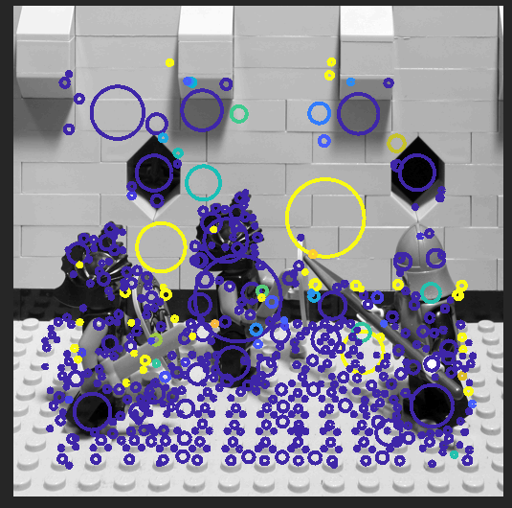
Where Feature Detection & Matching Fails
[Donald Danserau]
…Occlusions

Slide 4
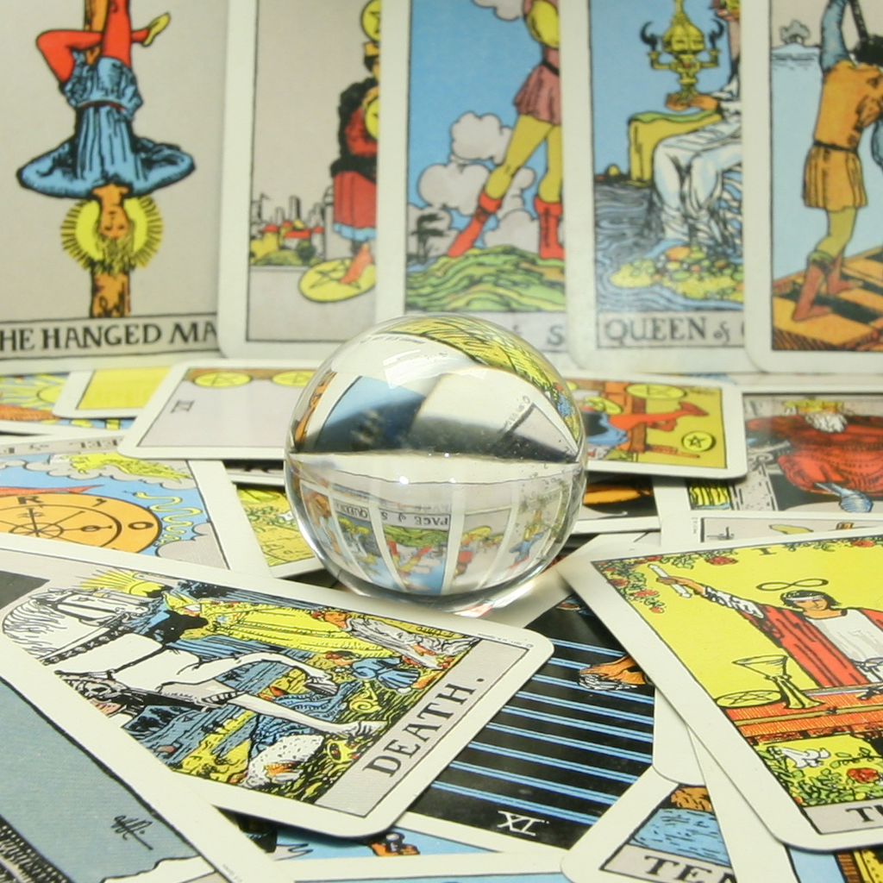
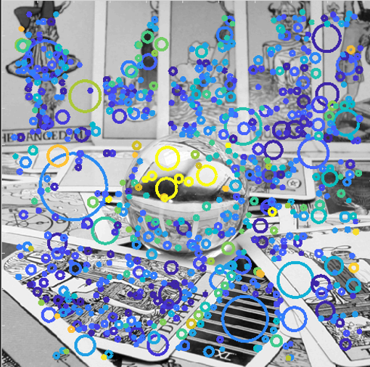
Where Feature Detection & Matching Fails
[Donald Danserau]
…Reflective and Refractive Objects

Slide 5
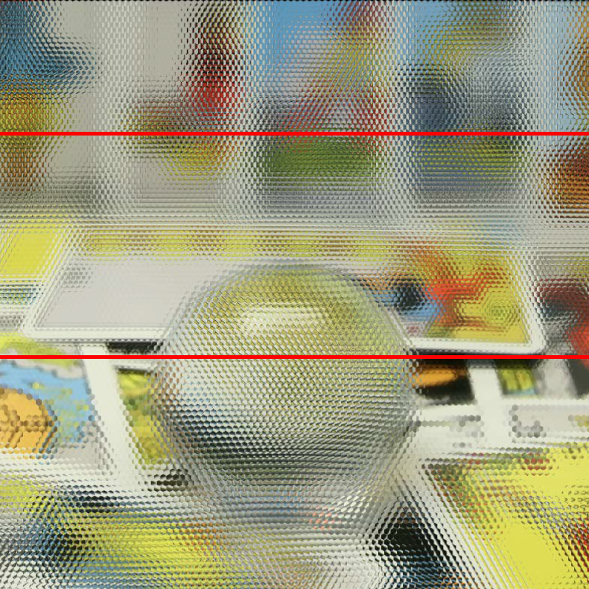
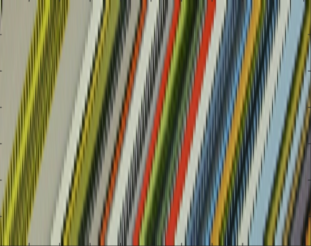
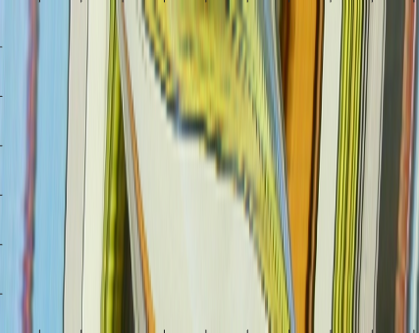
Light Fields are good at these!
Lambertian,
no occlusions
Non-Lambertian,
occlusions
[Stanford Light Field Archive]
Notes:
Explain EPI if not known to audience

Slide 6
Registration Failure due to Occlusions
2 Lytro Illum images treated in 2D

Slide 7
Registration Failure due to Occlusions
All putative matches
Post-RANSAC matches

Slide 8
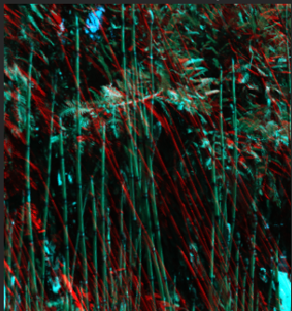
Registration Failure due to Occlusions
Rectified stereo images

Slide 9
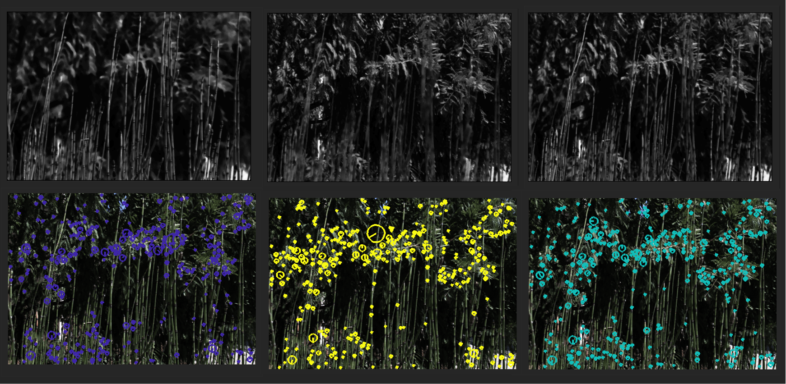
Fix : Focal Stack Features

Slide 10
All putative matches
Post-RANSAC matches

Slide 11
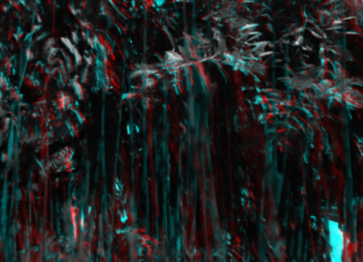
Fix : Focal Stack Features
Rectified stereo images

Slide 12
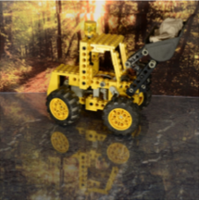
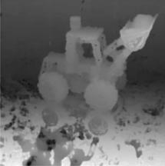
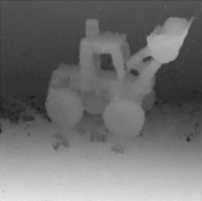
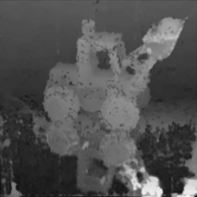
Depth Estimation Failure due to Reflections
Reflections cause spurious matches [Wanner2013]
This would be much nicer
Notes:
Spurious Matches
What’s happening?
This would be nicer

Slide 13
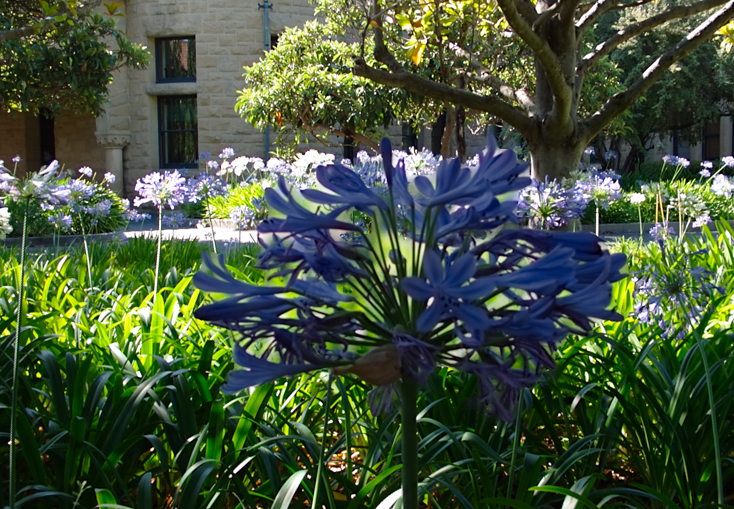
Formalization: Feature Quality Check
Notes:
What should the QC check for? Consistent depth and Lambertian!

Slide 14
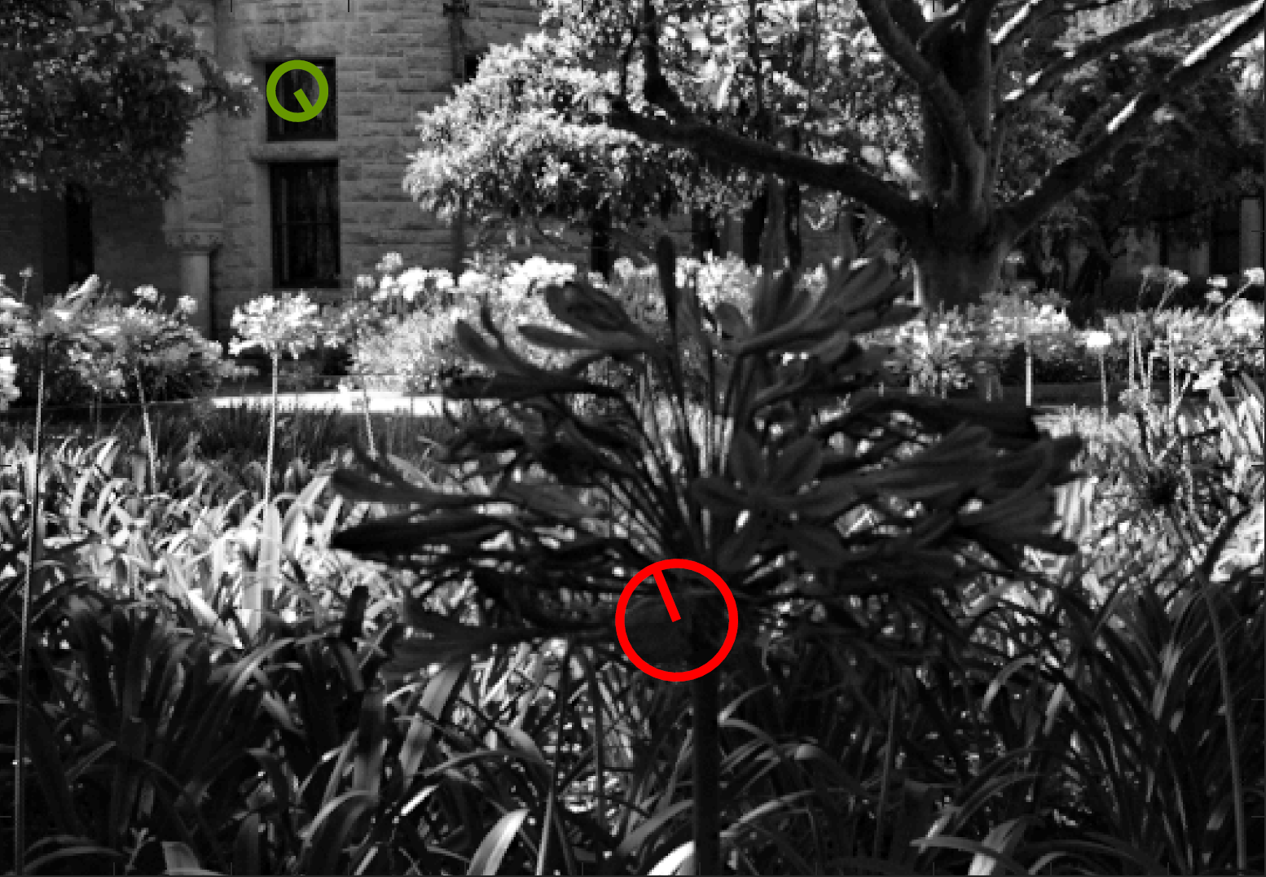
Formalization: Feature Quality Check
Notes:
What should the QC check for? Consistent depth and Lambertian!

Slide 15
Formalization: Feature Quality Check
Good Feature
Notes:
What should the QC check for? Consistent depth and Lambertian!

Slide 16
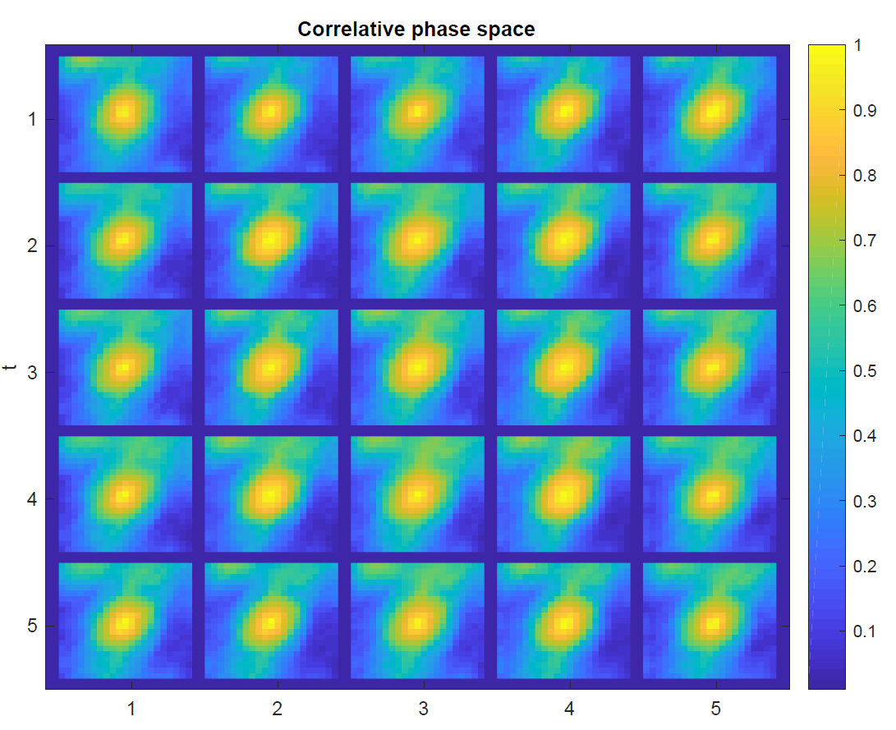
Formalization: Feature Quality Check
Good Feature
Notes:
What should the QC check for? Consistent depth and Lambertian!

Slide 17
Formalization: Feature Quality Check
Notes:
What should the QC check for? Consistent depth and Lambertian!

Slide 18
Formalization: Feature Quality Check
Bad Feature
Notes:
What should the QC check for? Consistent depth and Lambertian!

Slide 19
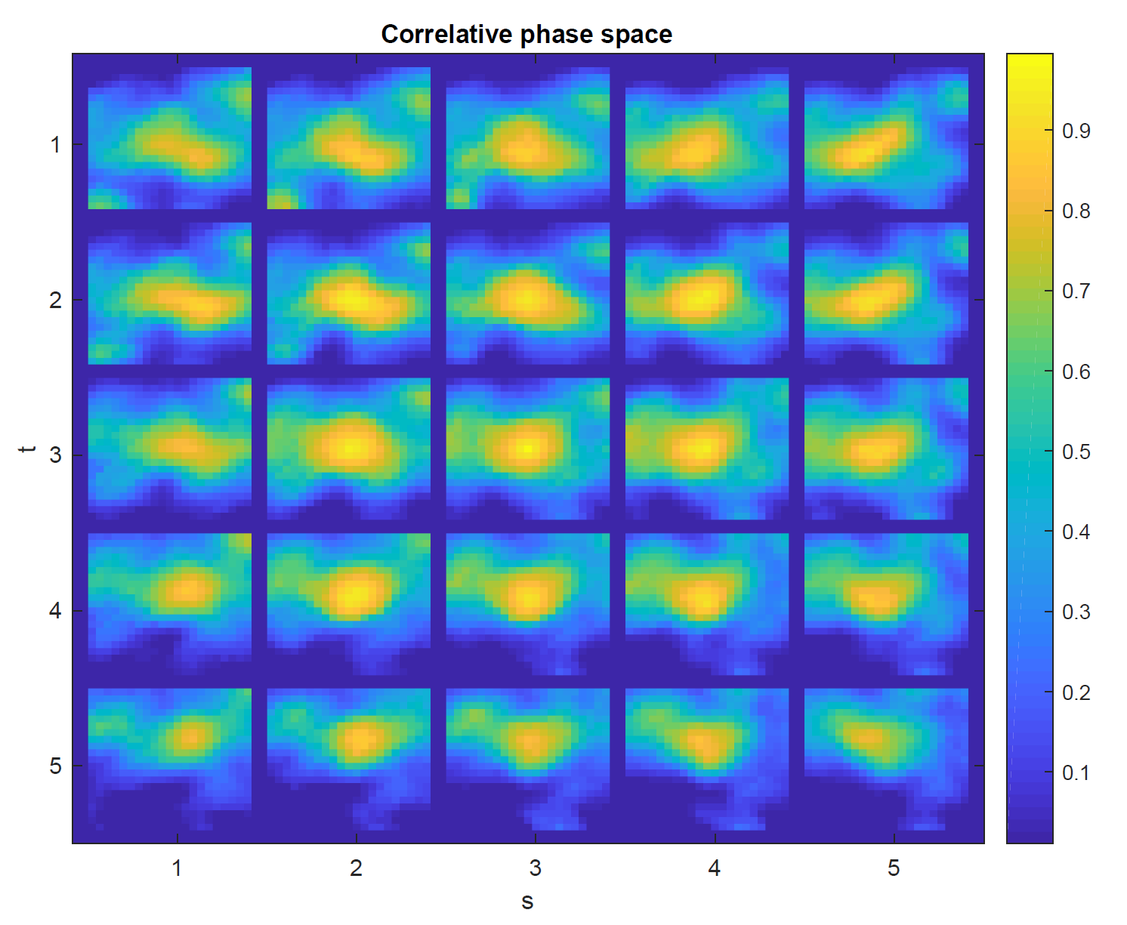
Formalization: Feature Quality Check
Bad Feature
Notes:
What should the QC check for? Consistent depth and Lambertian!

Slide 20
How can we use these insights to detect better features?

Slide 21
Approach
Data Acquisition
Data Augmentation
Evaluation
Convolutional Model
Notes:
EXPLAIN: Why Machine Learning:
A lot more information goes into training than into the model
Learn and make predictions without extra information (Light Field + SfM vs Focal Stack)
Hand-crafted is very time consuming – 1min vs milliseconds

Slide 22
Data Acquisition
+ COLMAP

Slide 23
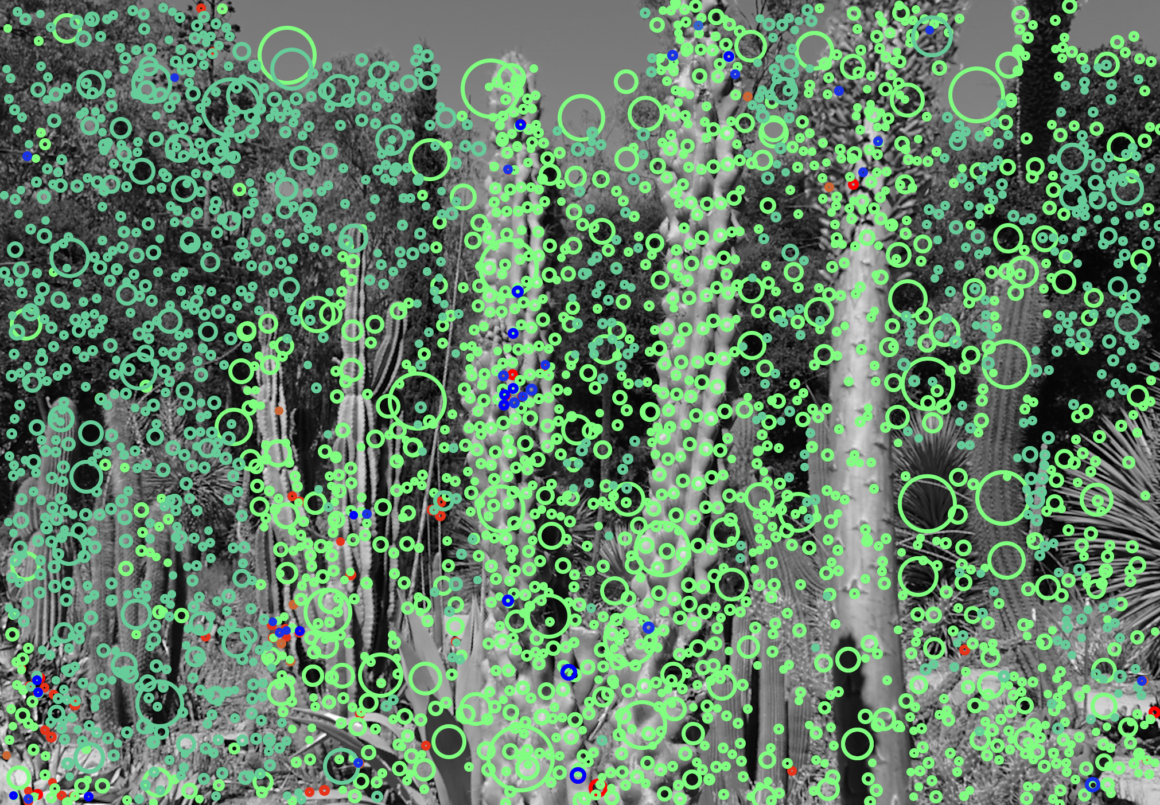
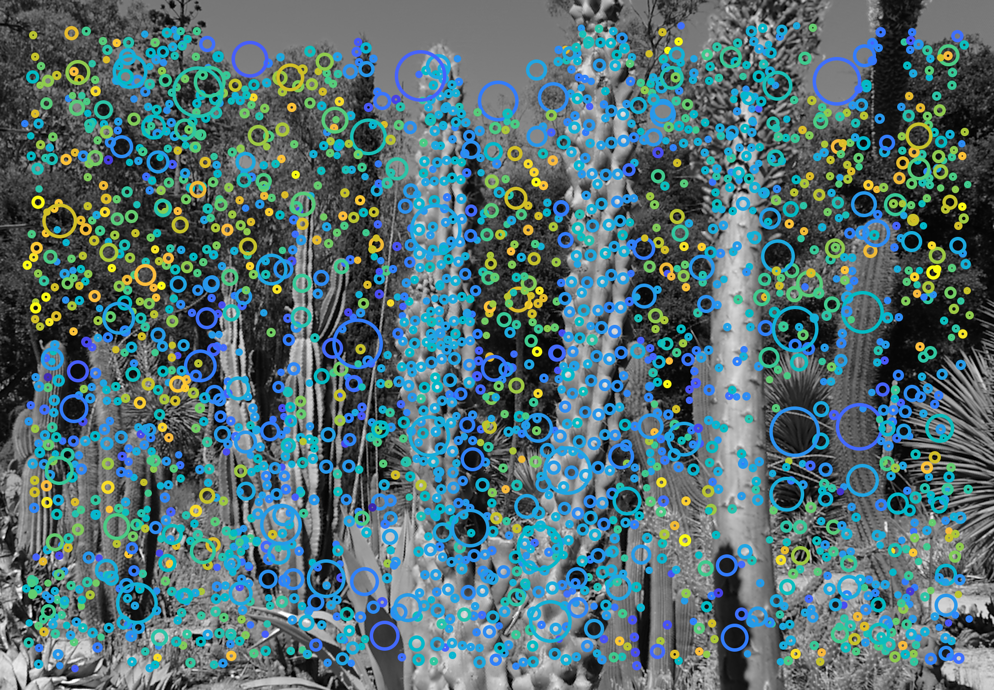
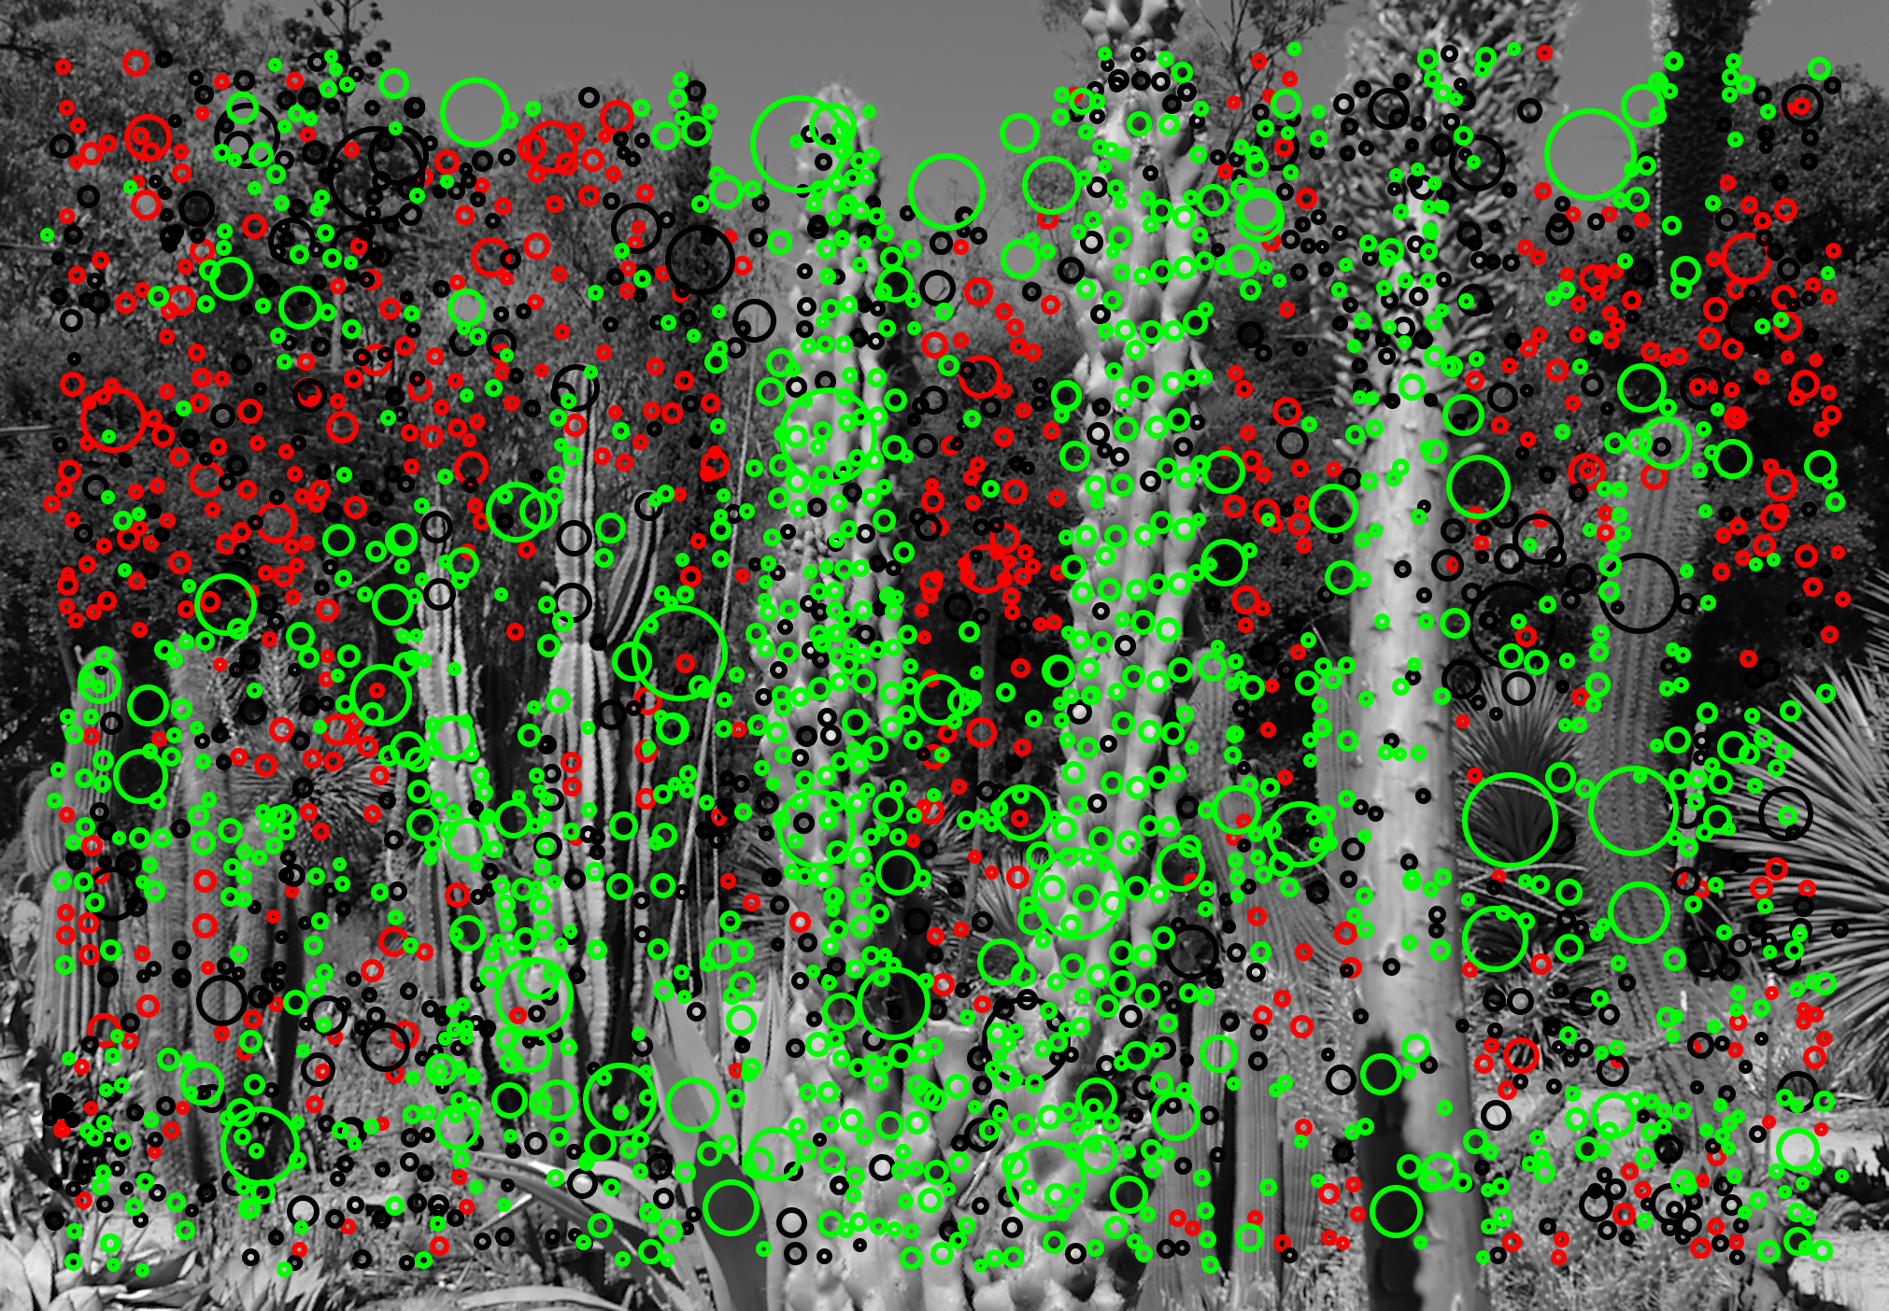
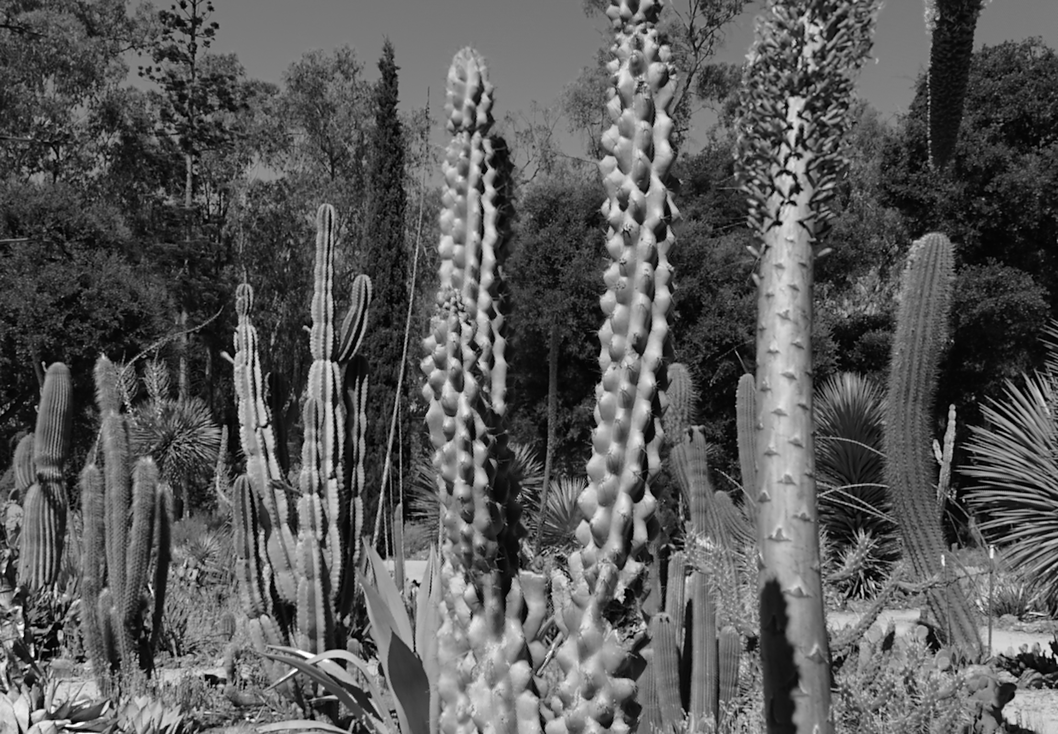
Detecting good and bad features
Different features on different focal slices (LiFF)
Scores obtained from Quality Check (QC)
Use COLMAP to get features that are definitely good

Slide 24
Data Augmentation
+ COLMAP

Slide 25
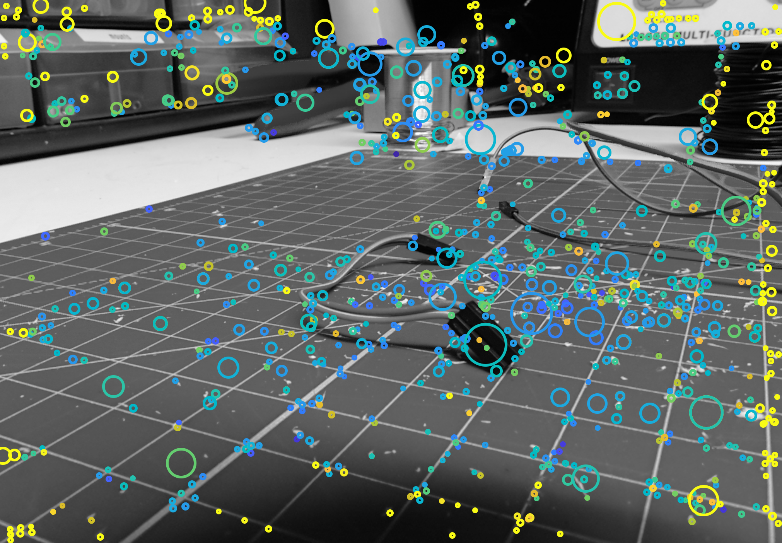
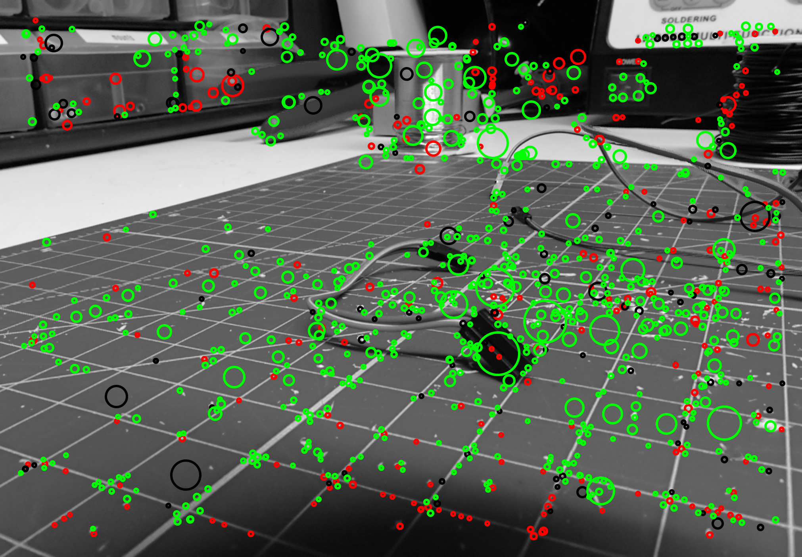
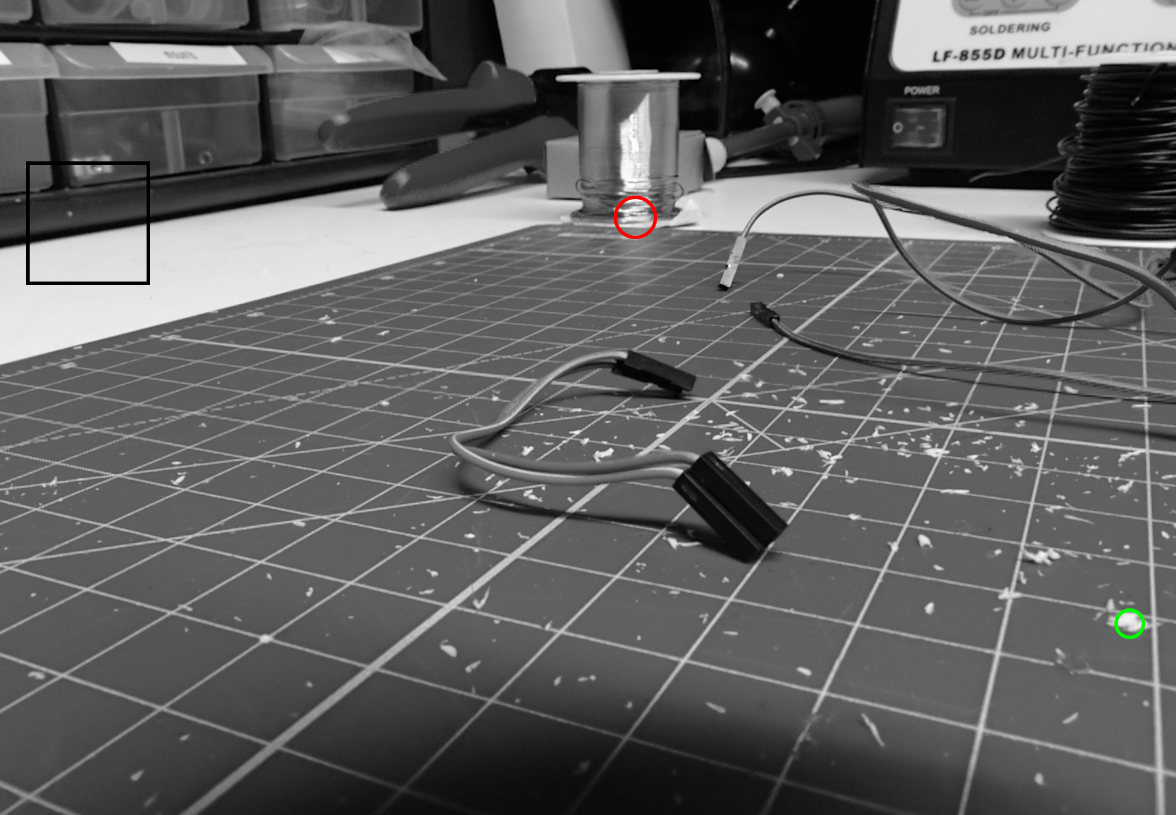
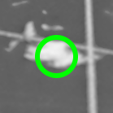
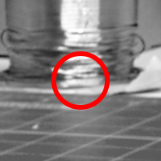
Sampling Training Data
random
good
bad (difficult)

Slide 26
Convolutional Model
+ COLMAP
Notes:
EXPLAIN: Why Learning??

Slide 27
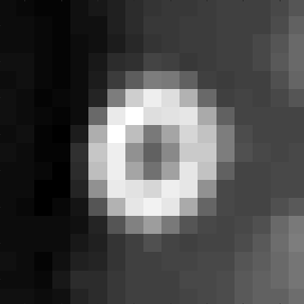
During Training: CNN as Binary Classifier
$y∈\{0,1\}$ = {bad, good}
Focal Stack Feature
3D-CNN
Binary Label

Slide 28
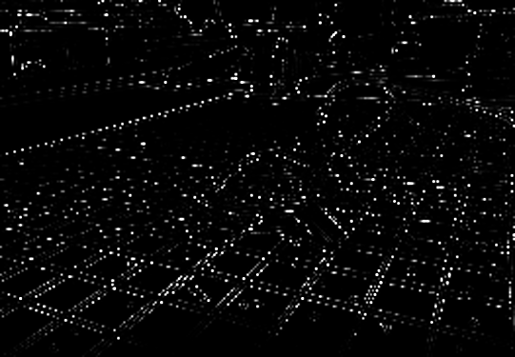
Detection on focal stack
3D-CNN
“sliding cube”
3D Heatmap
Focal Stack

Slide 29
Detection on focal stack
Scales
3D-CNN
“sliding cube”
Focal Stacks
4D Heatmap
Notes:
Mention non-maxima-suppression

Slide 30
Evaluation
+ COLMAP

Slide 31
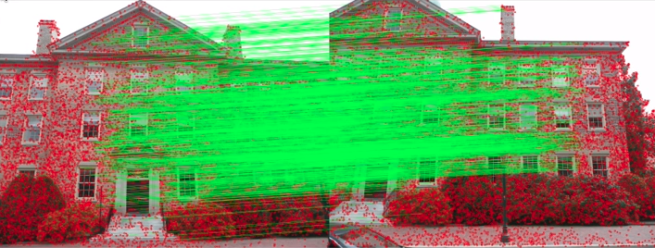
Evaluate using structure from motion
[COLMAP tutorial]
Calculate SIFT Descriptors
Match 2D Images Pairwise
Check Geometric Consistency
Get 3D Points → Performance Metrics
Putative Match Ratio = # of detected features / # of putative matches
Precision = # of putative matches / # of inlier matches
Matching Score = # of detected features / # of inlier matches
[schoenberger2017]

Slide 32
Preliminary Results
Still detects edges
Predicts at one scale
COLMAP training and evaluation not yet included

Slide 33
Focal stack features perform better on structure from motion!
Failed (2D SIFT)
Success (LiFF)

Slide 34
Focal stack features perform better on structure from motion!
Method | %pass | NPass /62 | Keypts / Img | Putative Matches / Img | Inlier Matches / Img | Match Ratio | Precision | Matching Score
SIFT + Colmap Defaults | 38.71 | 24 | 1469 | 128 | 122 | 0.13 | 0.94 | 0.13
LiFF v11 + Colmap Defaults | 50.82 | 31 | 1101 | 137 | 132 | 0.20 | 0.95 | 0.20
Evaluated on 62 scenes (2 from each category)

Slide 35
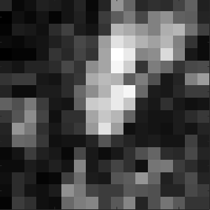
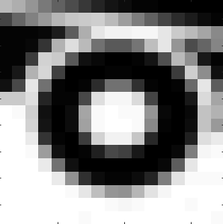
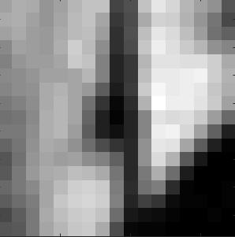
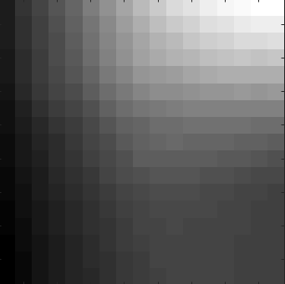
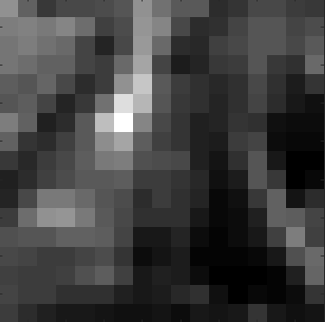
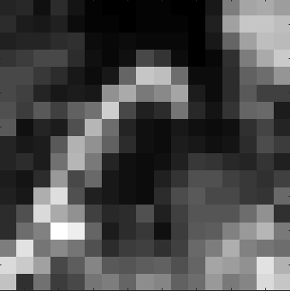
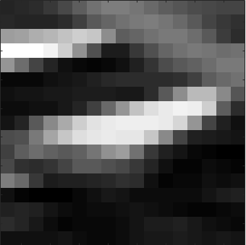
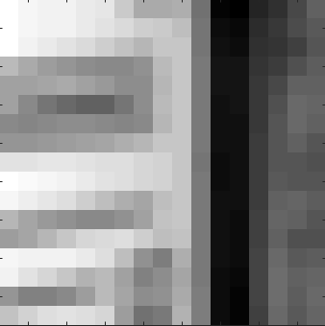
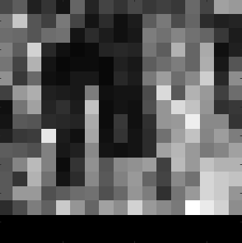
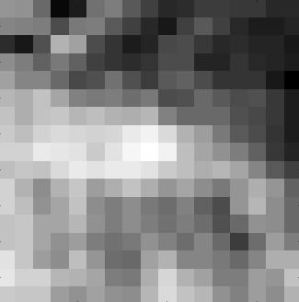
CNN Model Classifies 95.0% of patches correctly
Correct Positives (34.6 %)
Correct Negatives (60.4 %)
False Positives (3.4 %)
False Negatives (1.6 %)

Slide 36
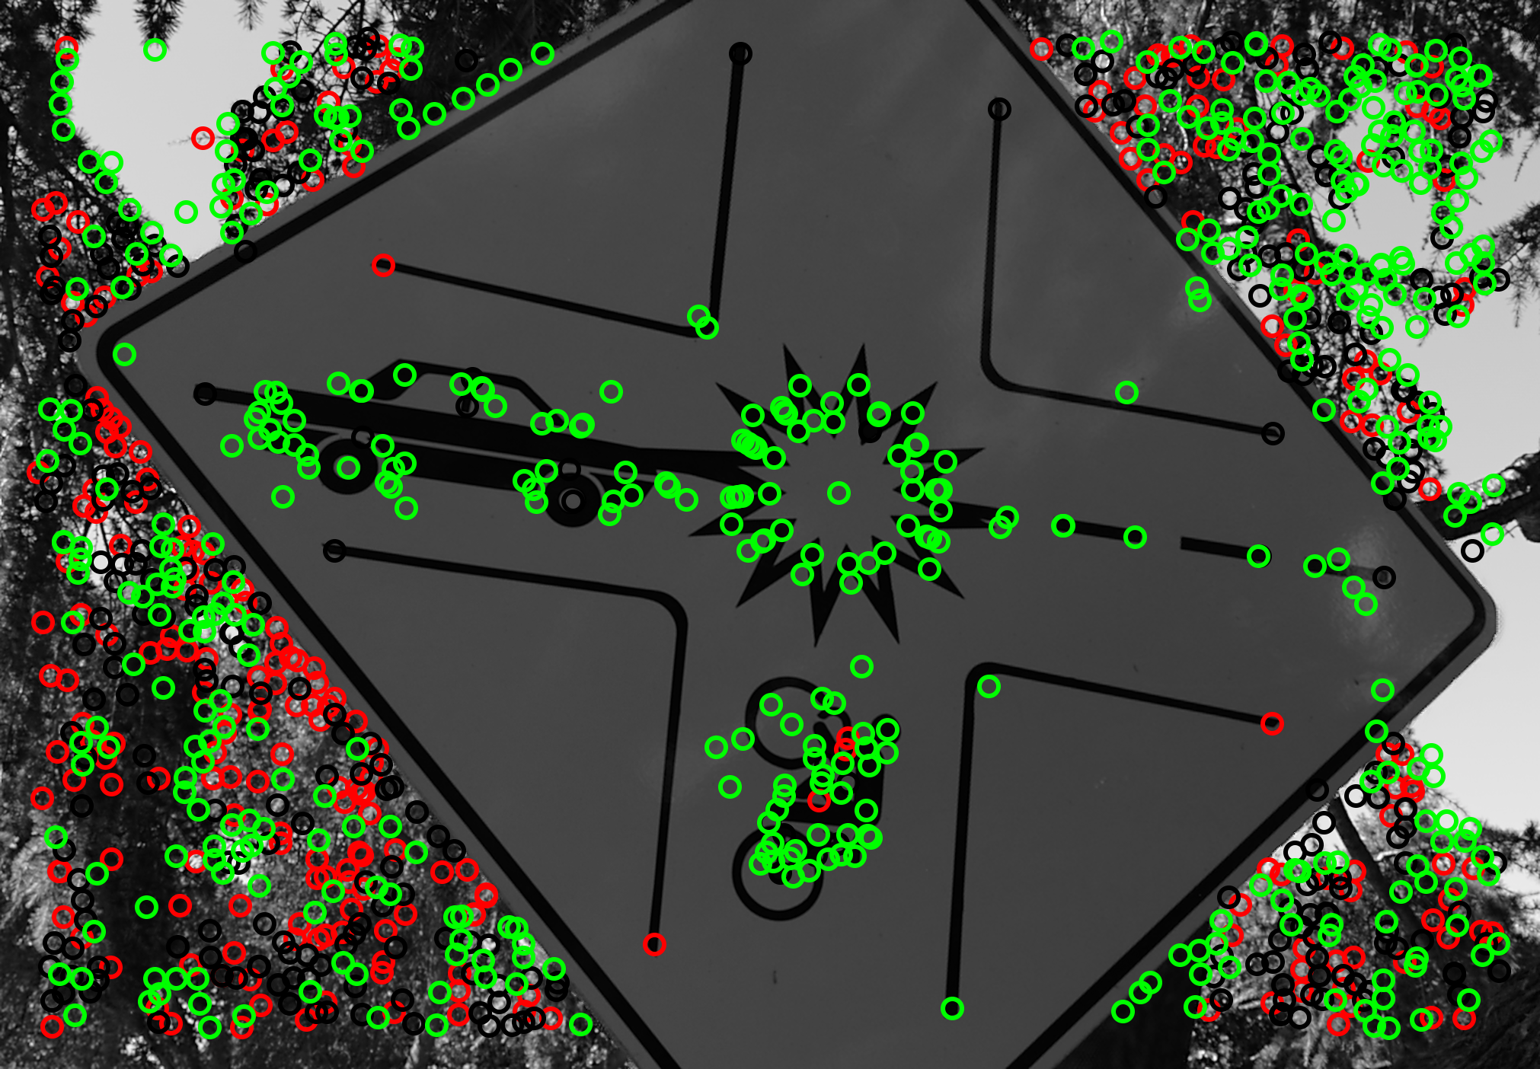
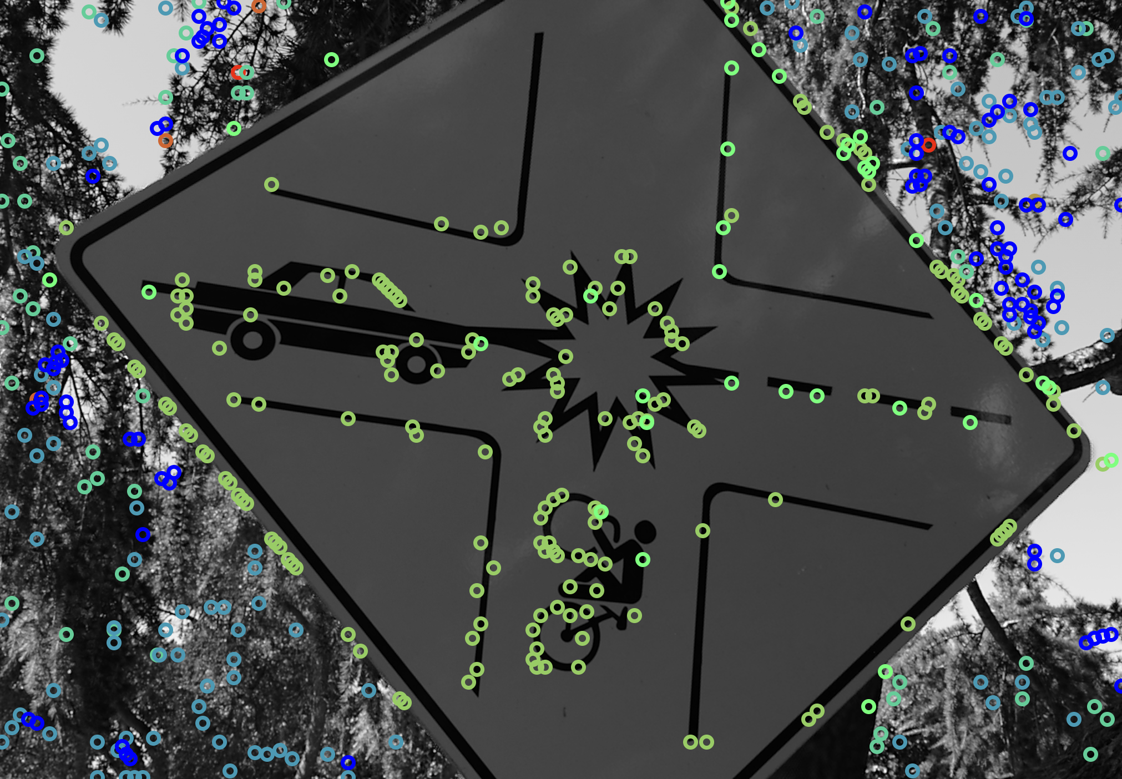
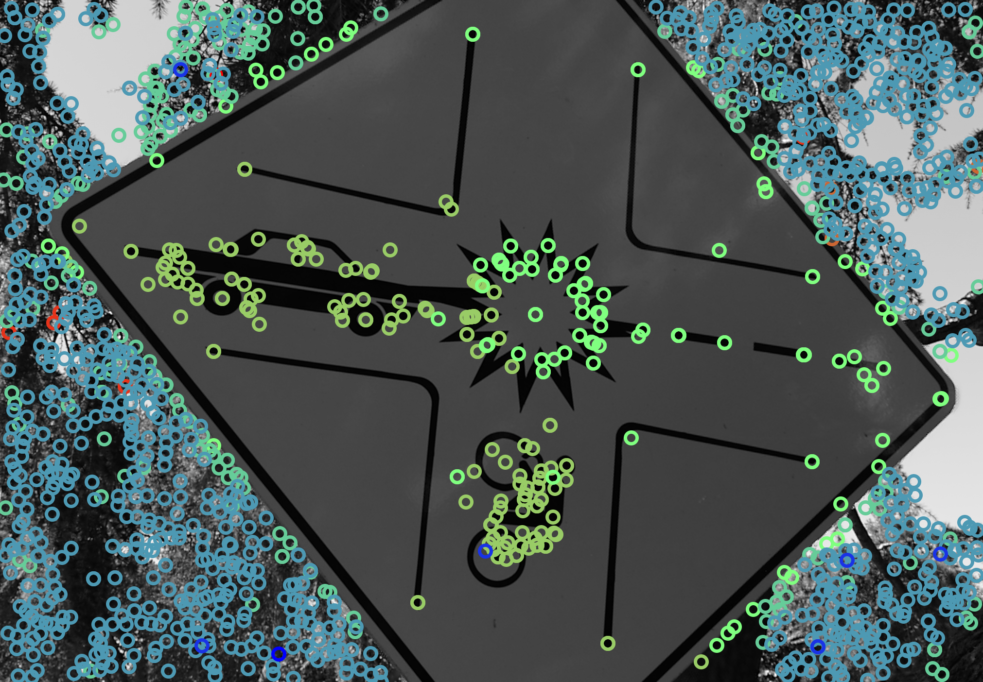
Most bad background features are removed
Handcrafted LiFF
LiFF + QC
Learned LiFF

Slide 37
Preliminary Detection Results
Depth is picked up nicely!
Learned LiFF
Handcrafted LiFF

Slide 38
Problem: Edges are detected
Fix: Include SIFT-detected edges as negative examples
Learned LiFF (single scale)
Handcrafted LiFF (single scale)

Slide 39
Problem: Edges Fix: Include Edges as Negatives

Slide 40
Further Dataset Improvements
Good feature
Disregard feature
Bad feature
DoG Value
Edge Value
QC Score

Slide 41
Future Work
Introduce scale-invariance to the model
Evaluate detected features with the proposed SfM metrics (COLMAP)
Use COLMAP to create better and more meaningful training data

