Slide 1
AR for the ARRISCOPE - Initial Registration
Lars Jebe
25 September 2018
Surgery Simulation Meeting
Matching Stereo Images with a CT Scan
Notes:
Goal: AR
This is the initial registration only
We see a model here, this is used throughout the presentation

Slide 2
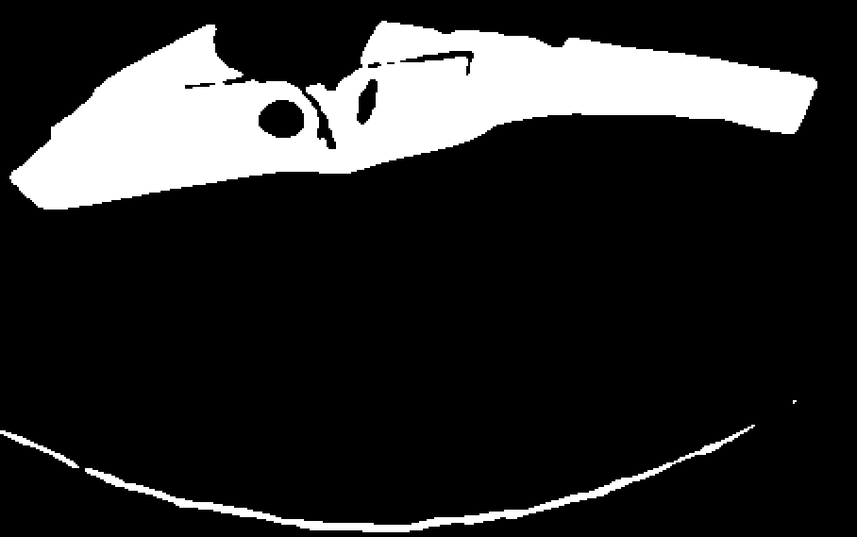
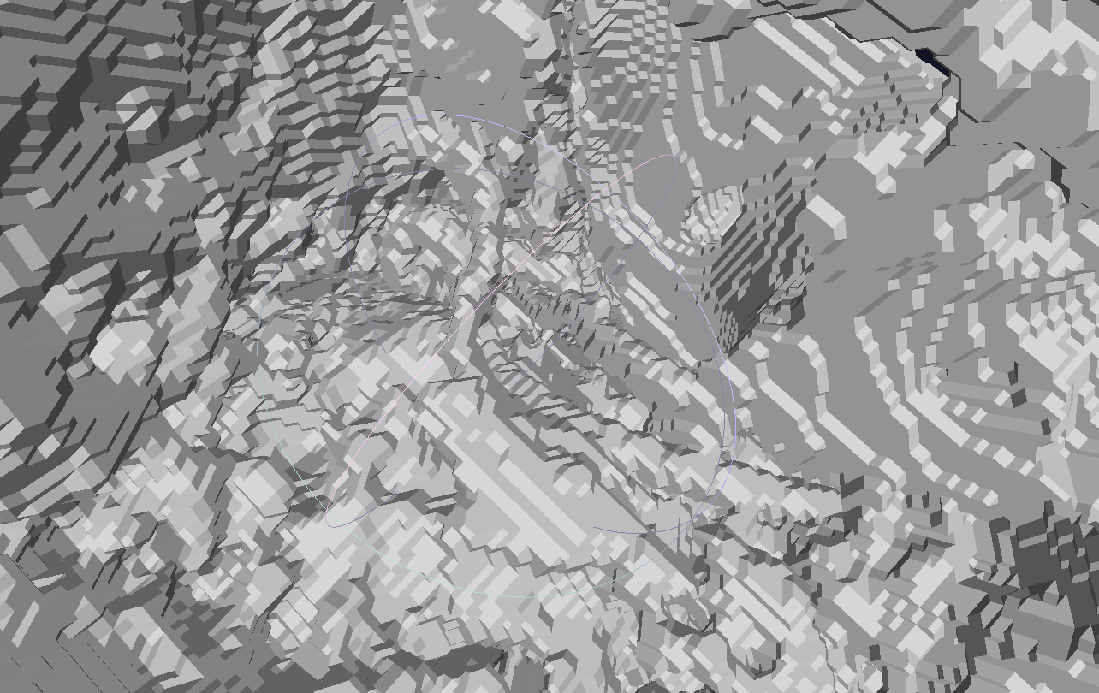
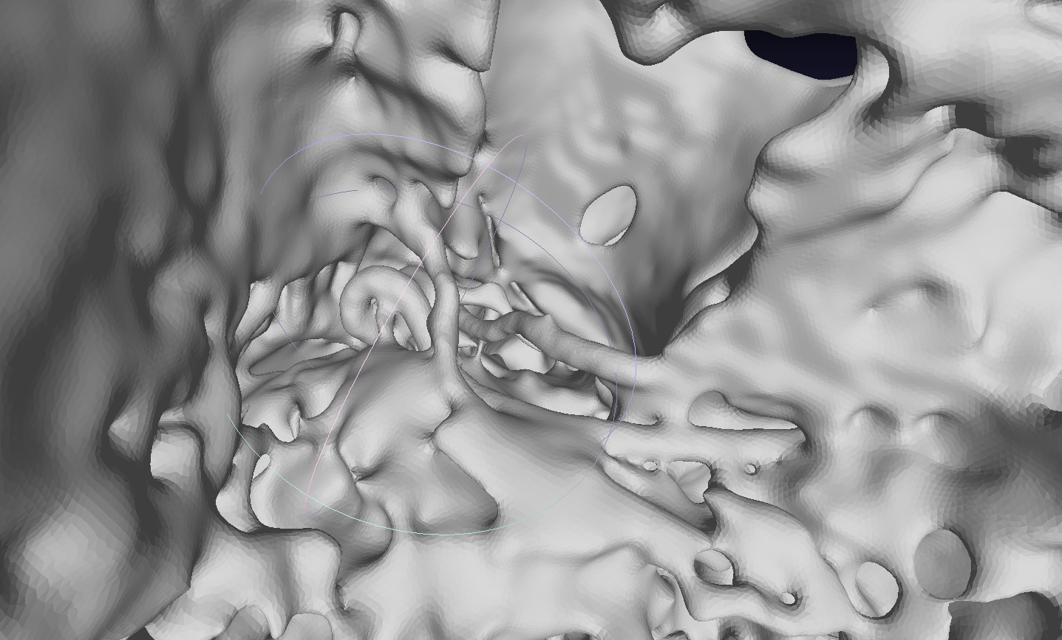
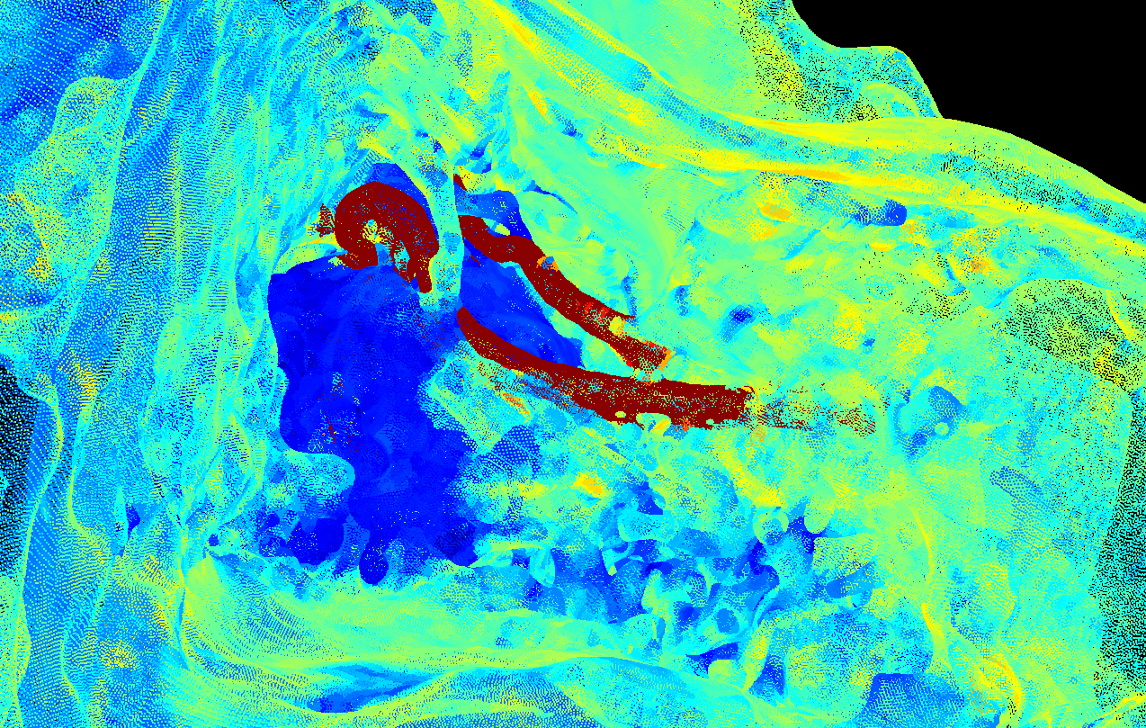
CT-Scan to 3D Surface Point Cloud
Binarize & Fill Holes
Convert to Surface Mesh
Smooth Mesh
Sample Surface Points
Thresholding,
3D small region removal
Simple ITK function
Laplacian Smoothing
Vertices,
Triangle Centers
Notes:
ITK = Insight Segmentation & Registration Toolkit
Color just for visualization

Slide 3
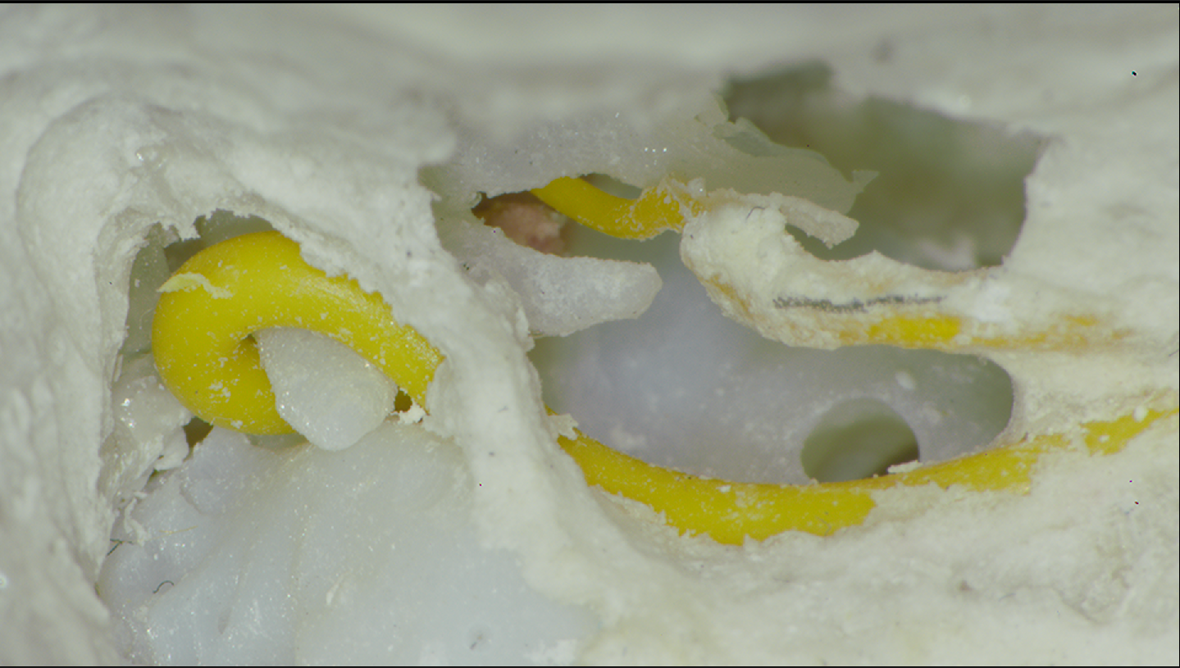
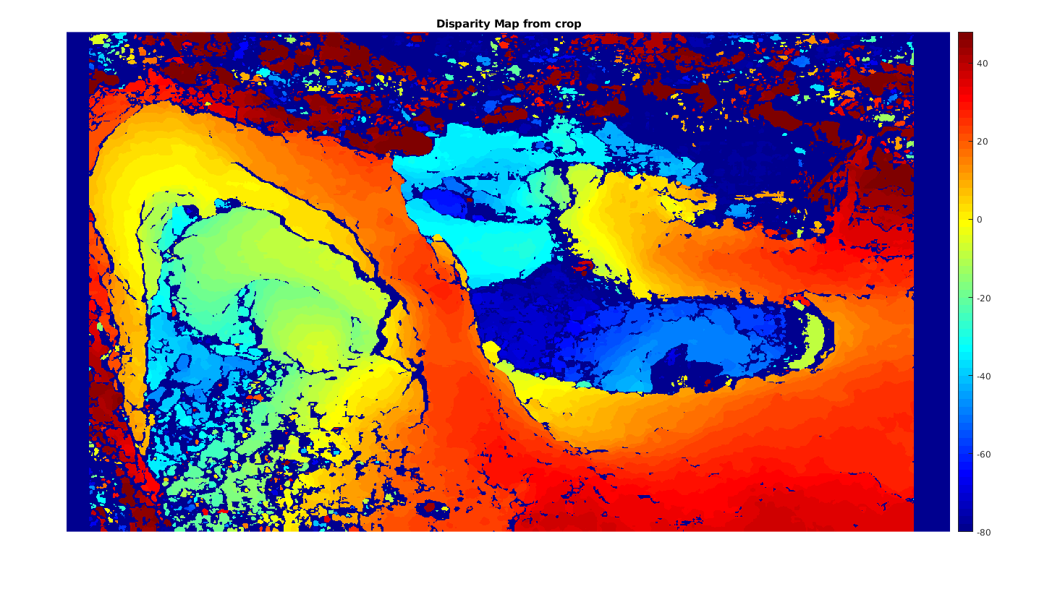
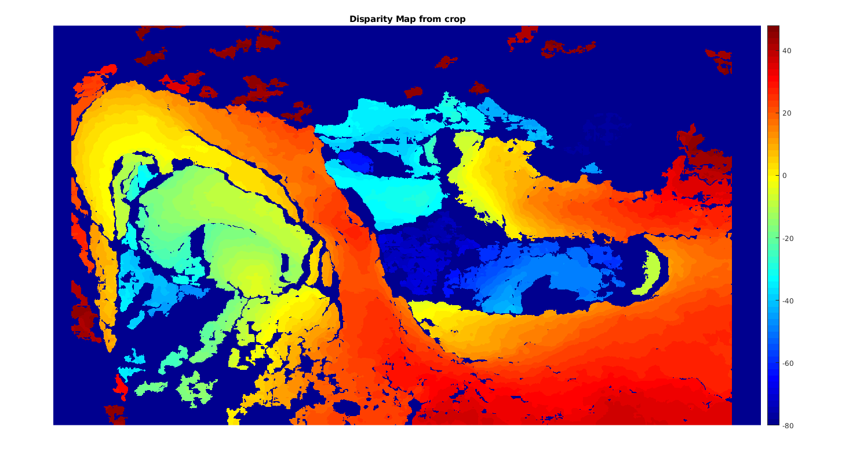
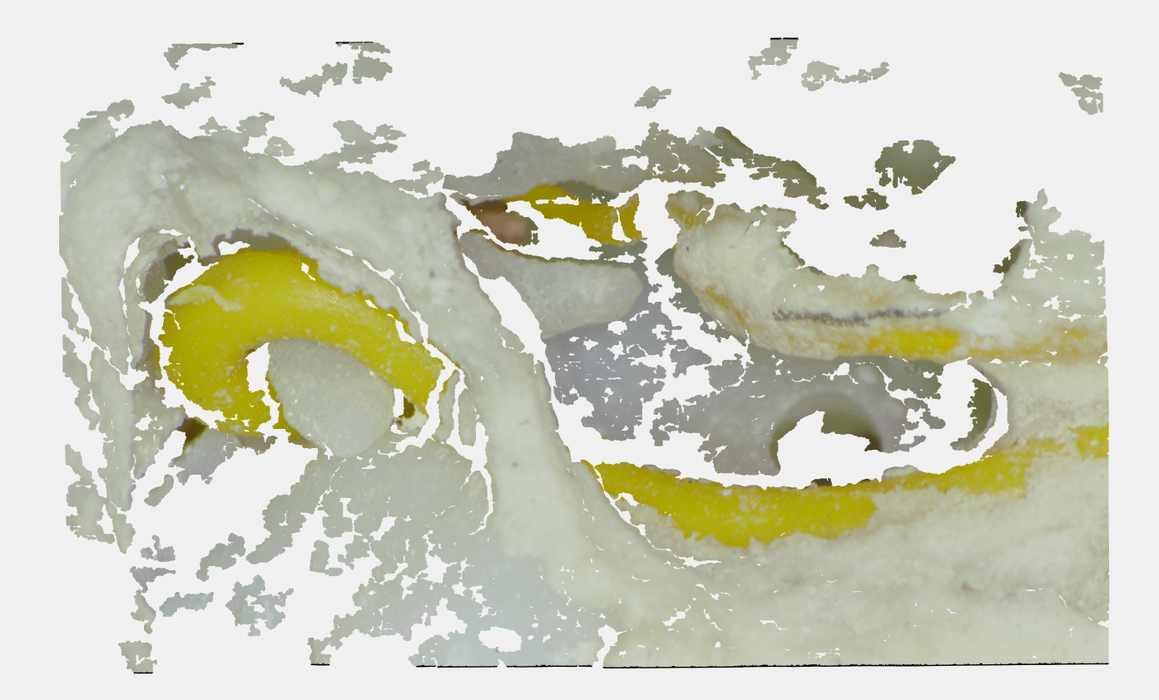
Stereo-Image to 2.5D Point Cloud
Rectify
Estimate Disparity
Convert to 3D Coordinates
Refine Disparity Map
Grayscale Small Region
Removal
Disparity to Depth,
Perspective – Orthographic,
Downsample
Using camera parameters
Block Matching

Slide 4
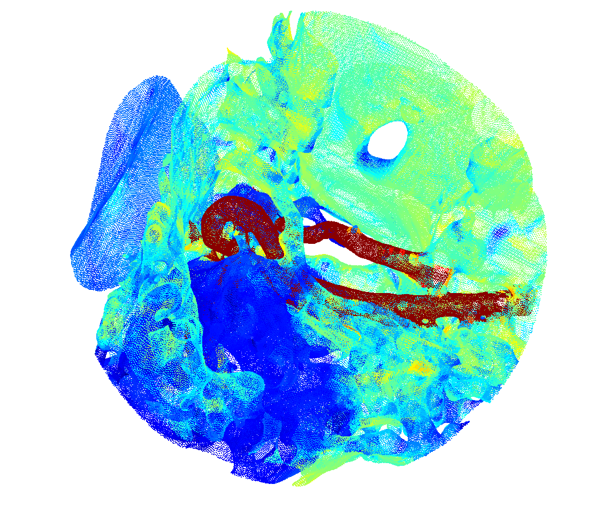
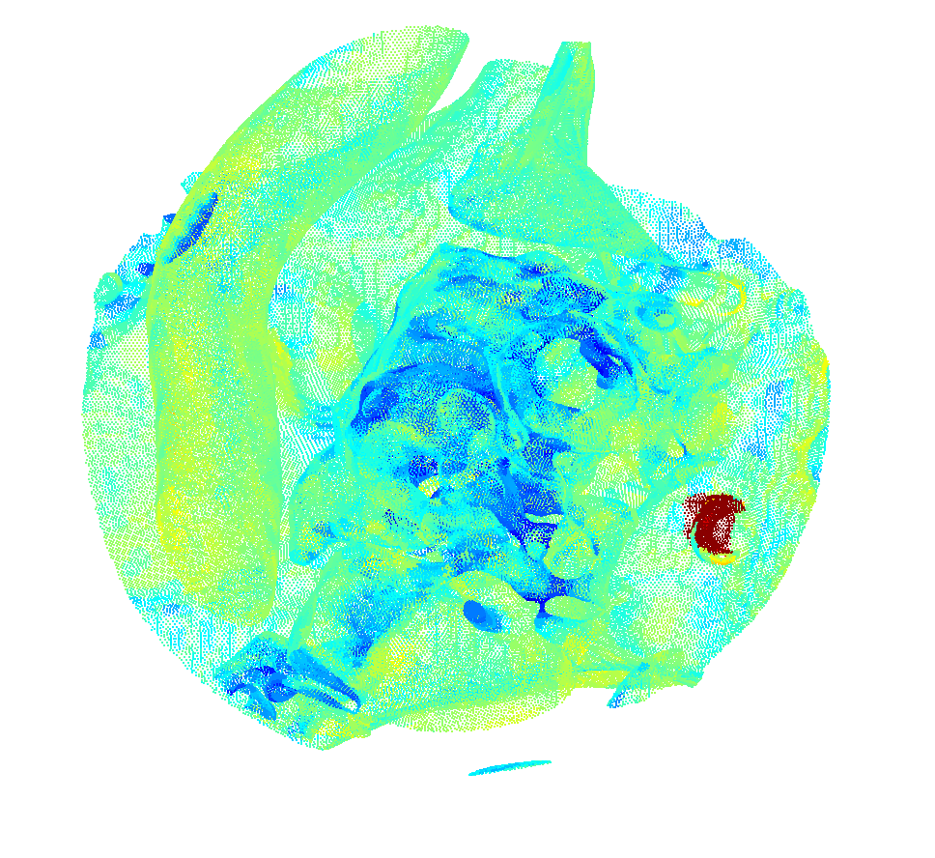
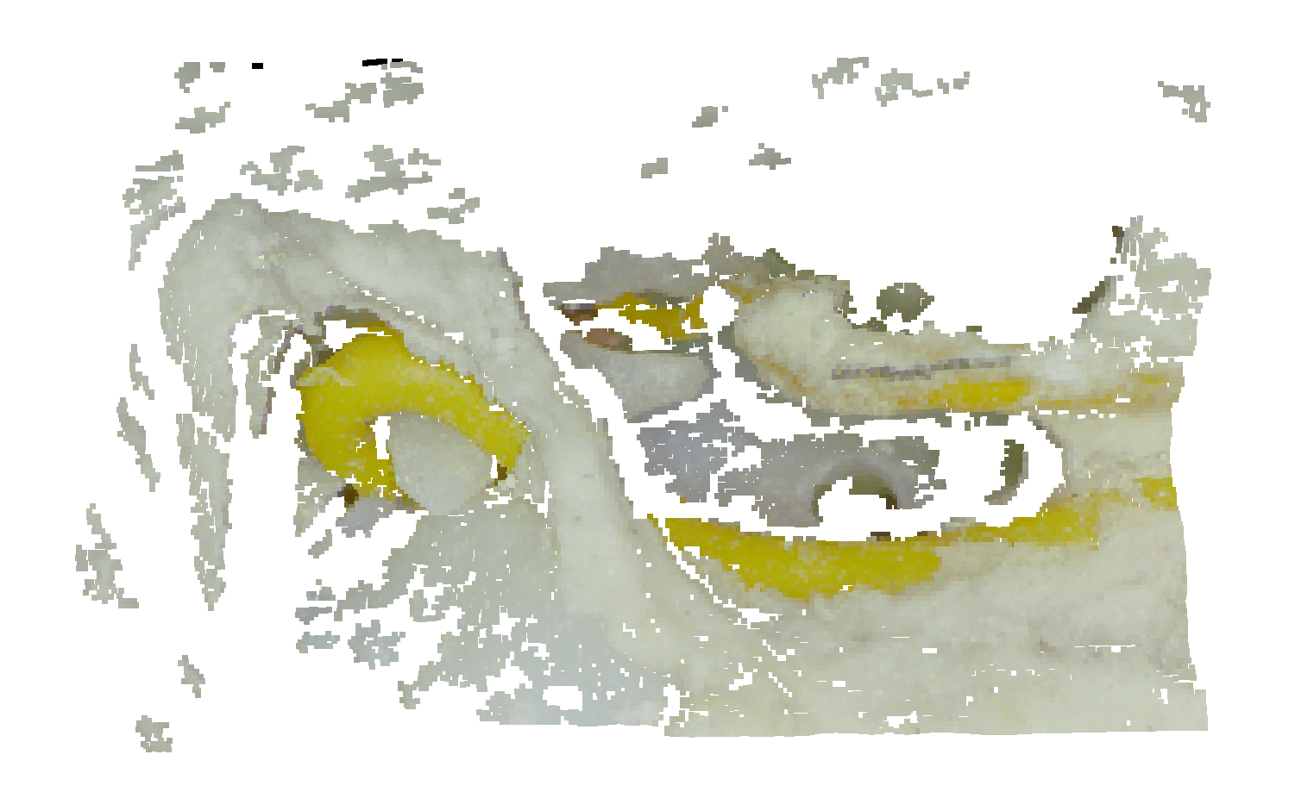
Registration: First Experiment Setup
3D Random Crop
2.5D Query
3D Correct Crop
Contains Query Surfaces
Contains 90% "Clutter"
Similar statistics to correct crop
Does not contain any query surfaces
Downsampled to match point density of 3D model
Notes:
Why spherical?
2 goals: retrieve correct sphere, and get correct alignment!

Slide 5
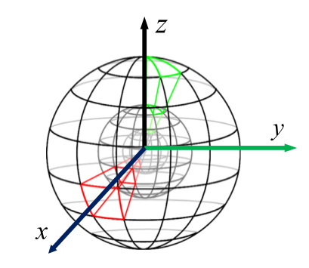
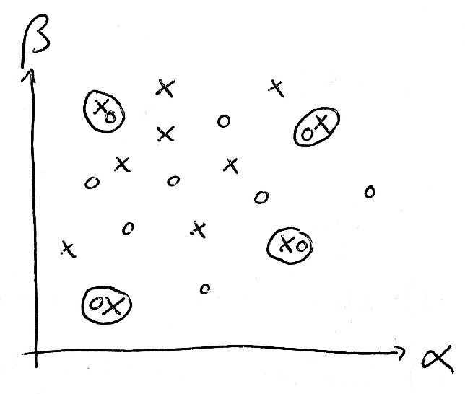
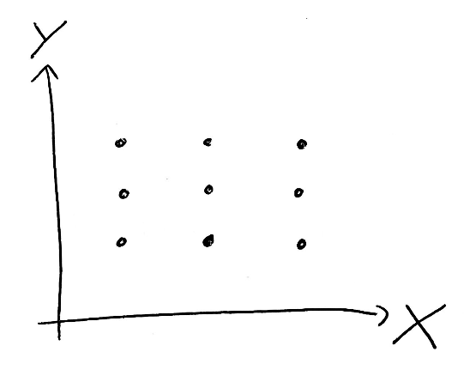
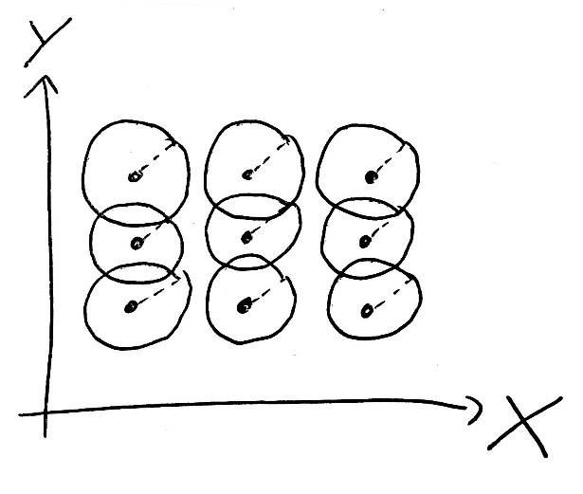
Approach: Local 3D Descriptor Matching
Keypoint Detection
Define Local Support Region
Calculate Descriptors
Match Descriptors
Random Uniform Sampling,
Quality Check
Spherical Support,
23-fold overlap
Histogram of Spatial Point Distribution
"L0.6"-distance,
Custom normalization,
SIFT matching method

Slide 6
Sampling unique & information rich keypoints
Sample Candidate Points
Point Count Criterion
Eccentricity Criterion
Random Uniformly
Nmin < N < Nmax
Ratio of Eigenvalues of Covariance Matrix
247,626 pts
61,001 pts
21,313 pts
Notes:
What’s important / new? Samples are NOT bound to existing points!
Why point count criterion? Explain especially Maximum!
Why Eccentricity?

Slide 7
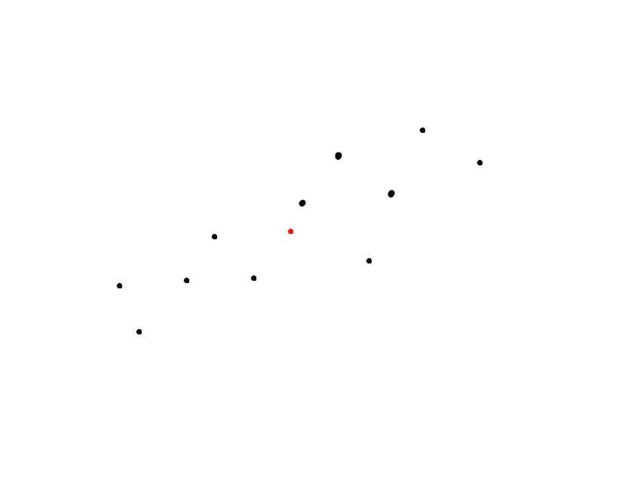
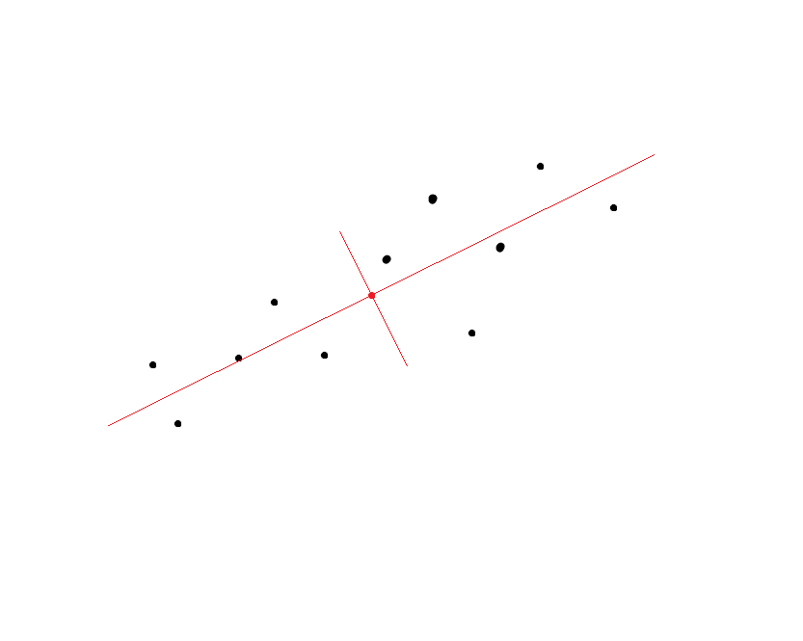
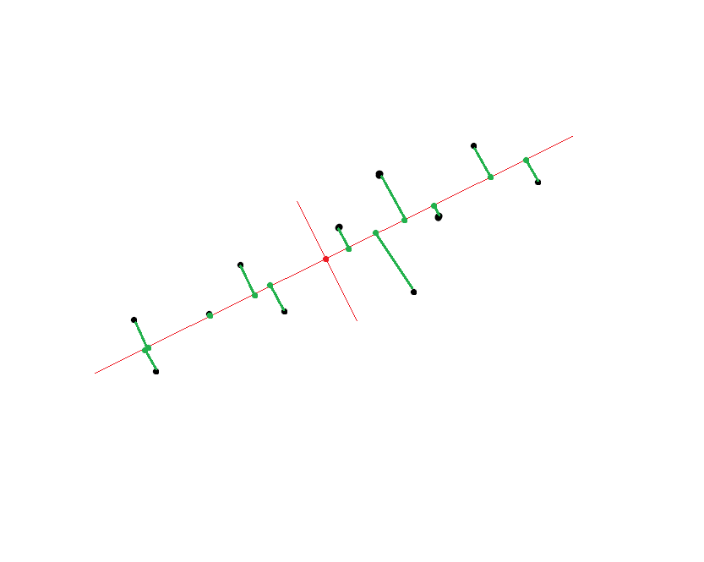
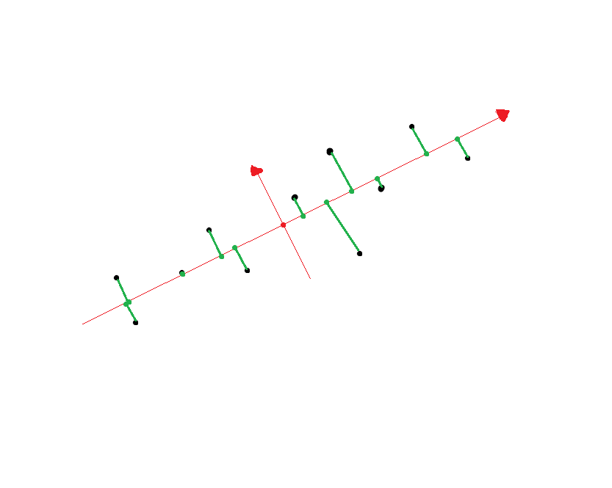
Align to local RF for Rotation Invariance
Find centroid
Construct reference frame from eigenvectors of point covariance matrix
Determine signs of eigenvectors by counting point projections

Slide 8
Align to local RF for Rotation Invariance
Alignment Failure
Alignment Success

Slide 9
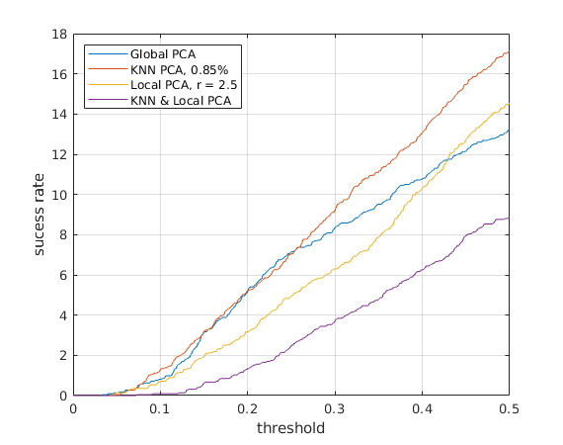
Improving Rotation Invariance
Alignment Success in %
Main Problem: Clutter
For robustness to clutter and outliers: use 85% closest points to centroid (KNN PCA)
Alternatively: Use points within certain distance to centroid (Local PCA)
Success, if smaller than the threshold

Slide 10
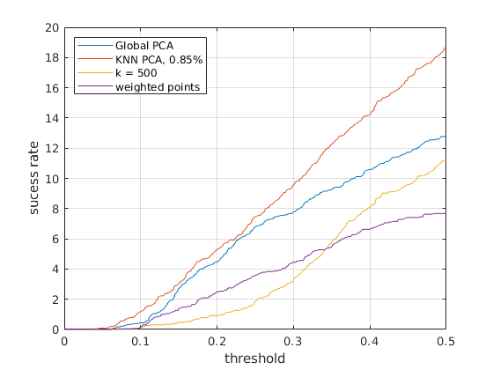
Improving Rotation Invariance
Alignment Success in %
[Mitra et al., 2004] proposes k-Nearest Neighbors (for local RA, not RF)
[Tombari et al., 2010] proposes weighting points by distance from centroid
KNN PCA with 0.85% works better here
Success, if smaller than the threshold
Notes:
Why KNN PCA better? IF points overlap, they’re very good. Outliers are very bad. Hard threshold makes more sense
Constant k difficult because of point count difference

Slide 11
KNN PCA improves the alignment
Alignment Strategy | Precision | # Inliers
Vanilla PCA + Sign | 12.5 % | 71
KNN PCA (85%) | 15.4 % | 56
Ground Truth Alignment | 57.4 % | 189
Ground Truth Alignment
Vanilla PCA fails
KNN PCA succeeds

Slide 12
Descriptors: Point Count Histogram
"Unique Shape Context" [Tombari et al., 2010]
Using binning of (10, 7, 14) for radial, elevation, azimuth dimension
Binning slightly reduced compared to author's recommendation --> less descriptiveness, more robustness, faster matching

Slide 13
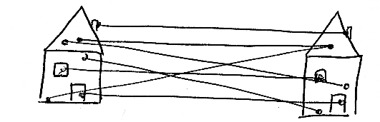
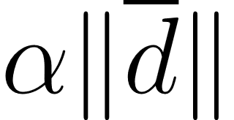
Finding Correspondences
Normalization makes the difference
Custom normalization by appending constant to descriptor
Constant value is with parameter , is average descriptor length
Matching metric is important for robustness to clutter
 | Precision w/ Correct Crop | # Inliers w/ Correct Crop | # "Inliers" w/ Random Crop
Vanilla SIFT Method | 9.3 % | 90 | 0
L1-distance | 10.2 % | 72 | 1
L0.6-distance | 12.0 % | 80 | 0
Custom normalization + L0.6-distance | 15.4 % | 56 | 0

Slide 14
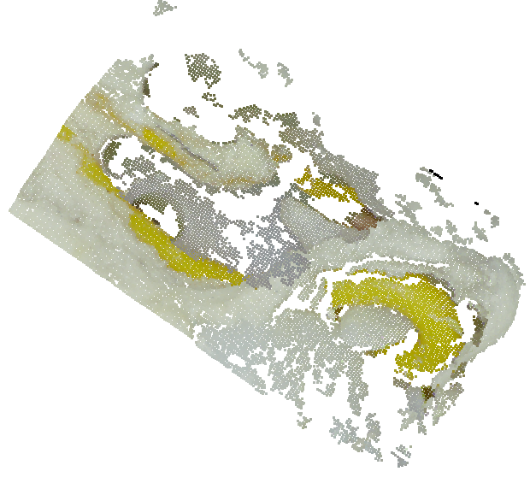
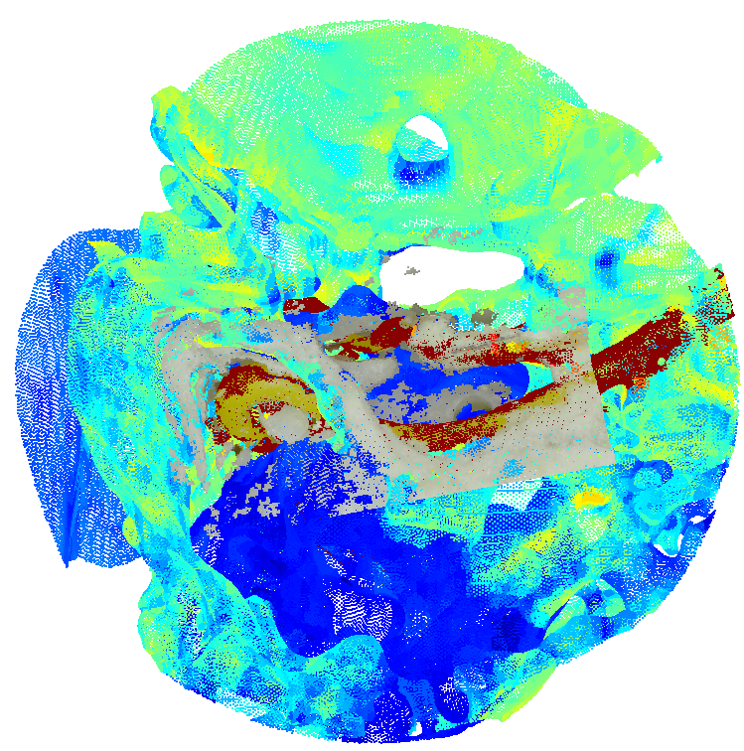
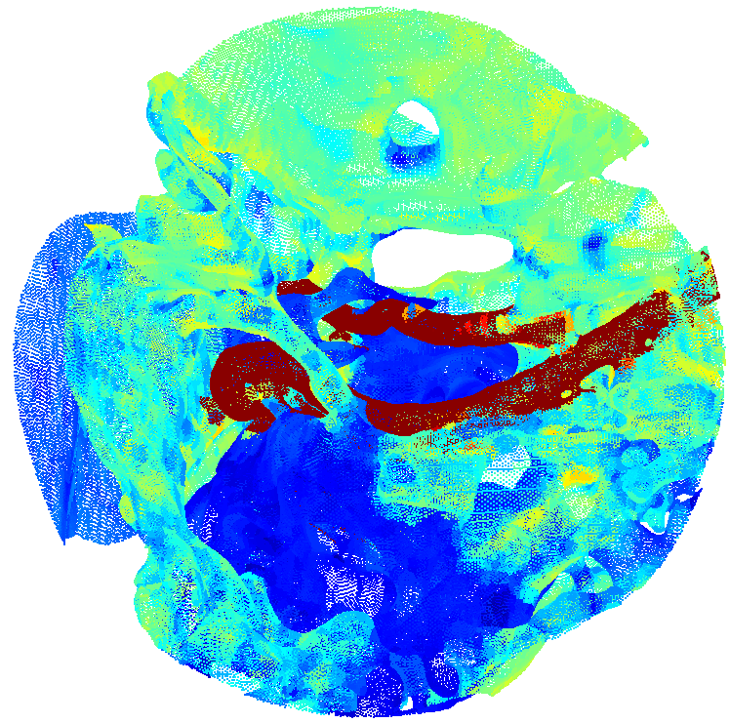
Estimating the transformation
RANSAC
Least squares estimation of 3D rigid body transform between point correspondences [Eggert, 1997]
RANSAC Parameters | Value
# of sampled points | 3
# of iterations | 30k
min. Inlier-Ratio | 10 %
Inlier-Distance | 0.2 mm
3D Model crop with registered 2.5D Surface
Notes:
Alpha = 2

Slide 15
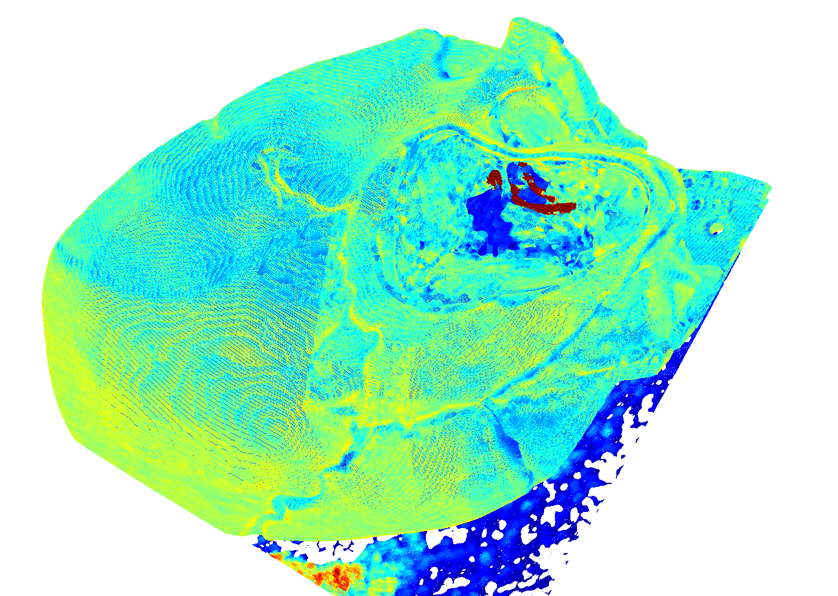
Retrieval on the whole model
So far, only considered one correct and one incorrect "database entry"
Calculate Descriptors
Match Spherical Subsets with Query
Retrieve Candidates
Geometric Consistency Check
Full Model
Center positions of spherical crops
Positions with most Putative Matches (blue)
Position where RANSAC found a transformation (red)

Slide 16
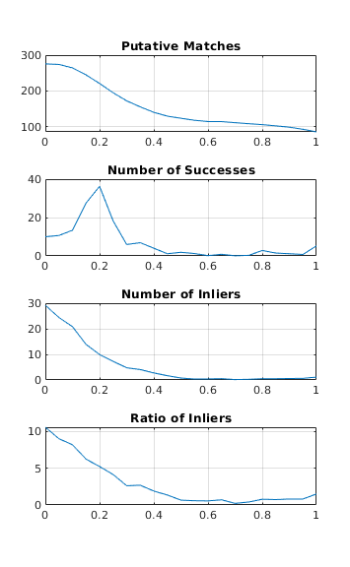
Determining Sampling Density
Slide sphere in random direction and match
Average over many different random directions
0
1
Notes:
Database entry = “spherical subset”
Dense: 10 fold – overlap. Sparse: 4-fold overlap.

Slide 17
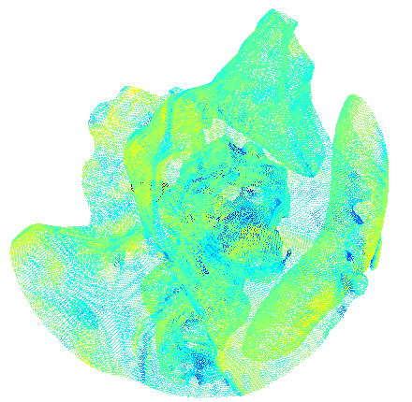
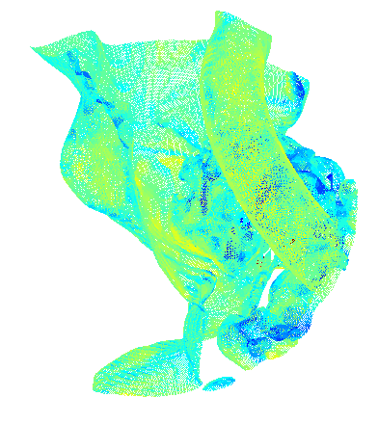
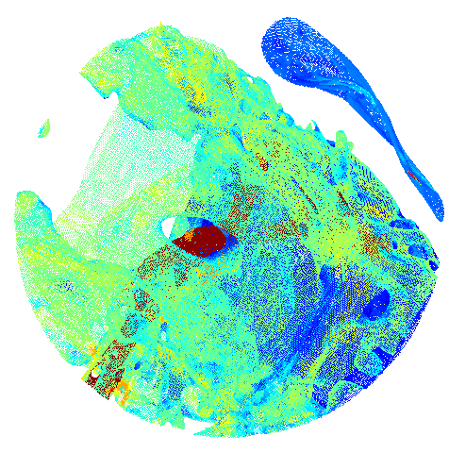
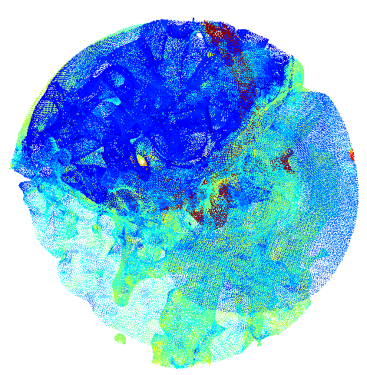
Sampling Spherical Subsets
Containing at least a minimum number of local descriptors
Match query to each one

Slide 18
Finding the matching region
5730 Matching Candidates
2773 RANSAC Candidates
61 RANSAC Successes
Consider only positions with most putative matches (blue)
Geometric Consistency Check on candidate positions

Slide 19
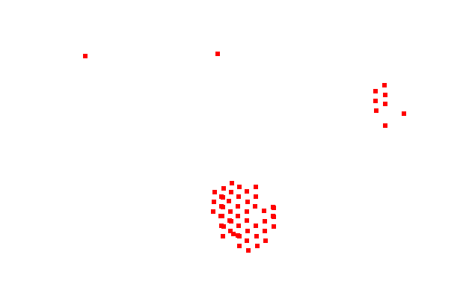
Obtaining the final transformation
Cluster regions
Select largest cluster
Aggregate all inlier matches from largest cluster
Run RANSAC again to obtain final transformation
61 RANSAC Successes
47 Correct Hits

Slide 20
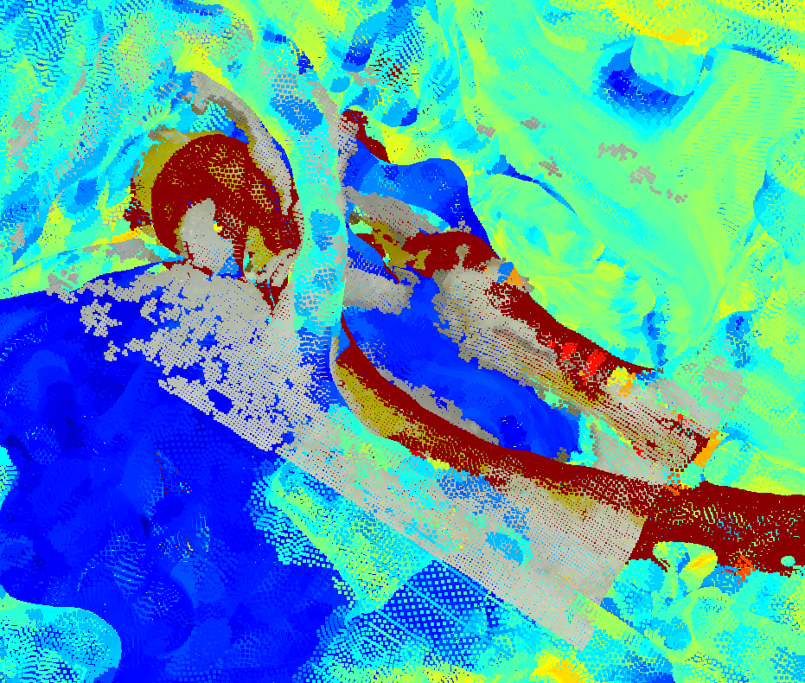
Allignment correct with +-1mm margin

Slide 21
Remember this?
Alignment Strategy | Precision | # Inliers
Vanilla PCA + Sign | 12.5 % | 71
KNN PCA (85%) | 15.4 % | 56
Ground Truth Alignment | 57.4 % | 189
Great way to check if alignment is correct
Check correctness: Use global alignment for descriptors and match again: 51.3 % inliers!

Slide 22
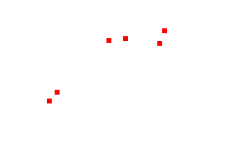
Speeding it up
366 Matching Candidates
168 RANSAC Candidates
6 RANSAC Successes
2 Correct Hits
Sample spherical subsets sparsely, match and run RANSAC on candidates
Cluster and match each cluster with globally aligned descriptors
Check which cluster has > 50 % inliers
RANSAC to refine estimate
Check: Transformation should be close to identity
16 % (1%)
37% (0%)
51% (19%)
Inlier-Ratio
permissive (strict)

Slide 23
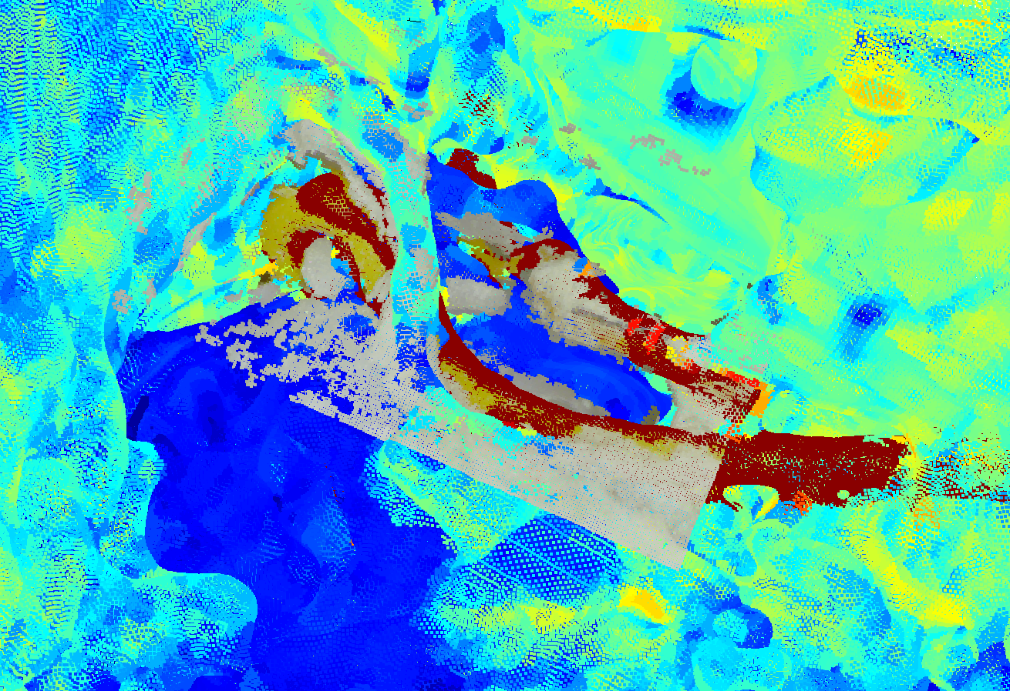
Allignment correct with +-0.5mm margin

Slide 24
Further (untested) ideas for improvement
Definition of local descriptor neighborhood based on mesh neighbors, rather than spherical support region
1
3D-Model: Render only points from mesh that are visible from the outside to reduce clutter
2

Slide 25
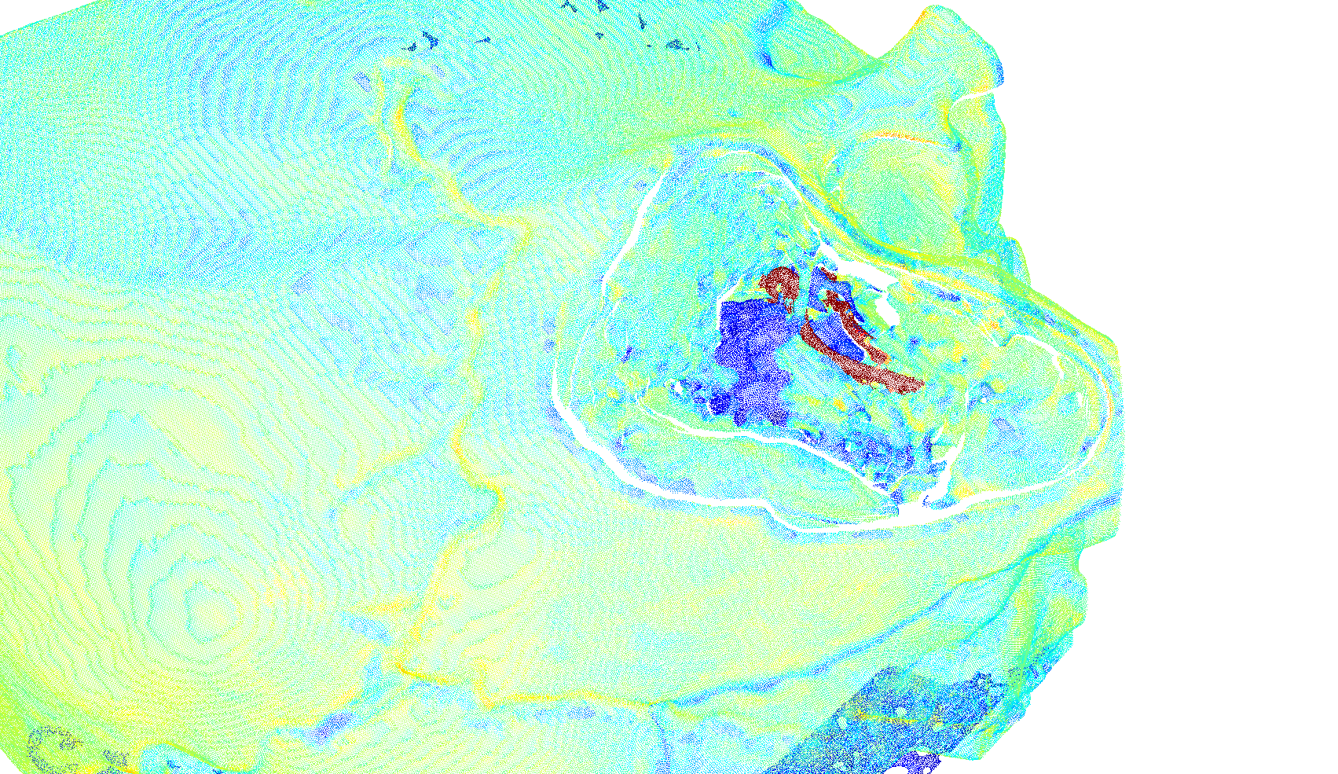
Update: Rendering Camera View from Mesh

Slide 26
Approach
Define camera parameters (6D Position, FOV etc.)
1
Repeat with different camera parameters
3
Render view (obtain visible surfaces)
2
Union over visible surfaces
4
Re-sample points
5

Slide 27
Results (1. Experiment)
Experiment | Precision | # Inliers
Best so far | 15.4 % | 56
Render | 19.1 % | 206
Render, tuned | 24.4 % | 313
Ground truth alignment, best so far | 57.4 % | 189
Ground truth alignment, render | 70.2 % | 798

Slide 28
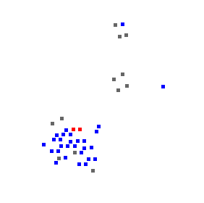
Results (Whole Model)
42 Matching Candidates
36 RANSAC Candidates
2 RANSAC Successes
2 Correct Hits

Slide 29
Next steps
Test algorithm on real dataset (will likely require additional modifications)
1
Efficient Implementation (Should be possible in <1min on a GPU)
3
Develop strategy for automatically segmenting tissue/ non-rigid material
2
Motion Tracking after Initial Registration is successful
4

Slide 30
Point Covariance Matrix
unweighted
weighted
[Tombari et al., 2010]

Slide 31
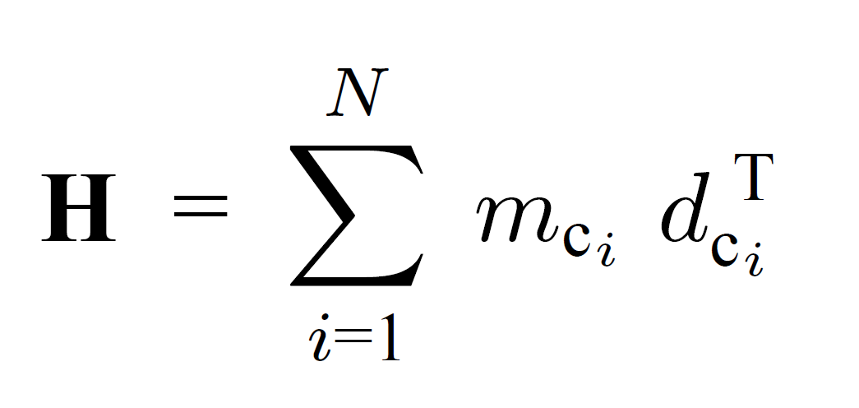
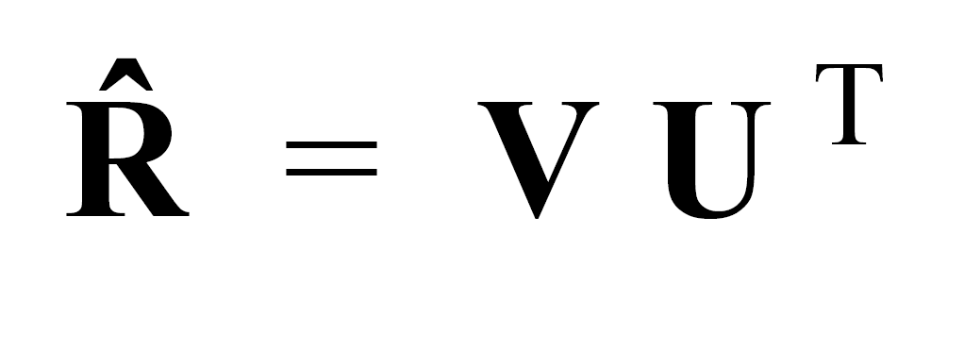
Estimating the 3D rigid transformation
From centered point sets
and
Singular value Decomposition
Minimizes this:
[Eggert et al., 1997]

